Slide 1
Competence By Design Program Evaluation

Slide 2
What is Program Evaluation?
Program evaluation is the systematic investigation of the quality of programs; in this case, CBD.
It is used for decision making, judgements, conclusions, findings, knew knowledge, organizational development, and capacity building
It helps to improve programs and systems
The evaluation of CBD will require a longitudinal, iterative approach guided by collaborative effort.

Slide 3
Why is Program Evaluation Important?
To ensure CBD is being implemented as intended and not having harmful effects
To help make any necessary improvements and to understand the impact of CBD
Signals that the Royal College is accountable to this initiative
Helps to provide scholarship on CBME, which is being increasingly adopted on a global basis

Slide 4
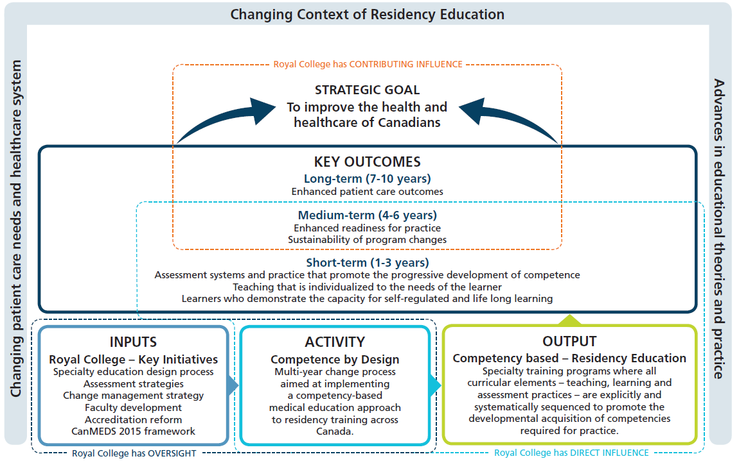
CBD Logic Model and PE Framework
CBD-RE PE Framework and Logic Model were drafted to help understand the program model, guide studies, and encourage collaboration.
Notes:
This logic models shows how CBD is supposed to work, and how various initiatives come together to facilitate the adoption and implementation of the CBD model. Implementation should then lead to programs aligning to support the progressive development of competencies, which then lead to short, medium, and long-term goals, and eventually to the strategic goal.
To help guide the program evaluation, and CBD-RE Program Evaluation framework has also been drafted.
(Goals of the framework are on the next slide).

Slide 5
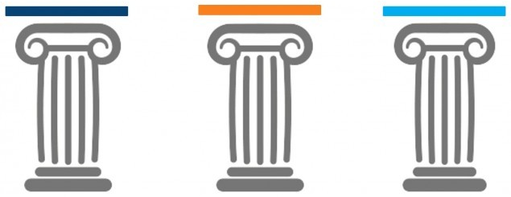
The Three Pillars of the Evaluation
The program evaluation has three pillars, each of which address a goal of the evaluation.
Readiness to Implement
Fidelity & Integrity of Implementation
Outcomes
Notes:
The goals of the CBD Program Evaluation, as outlined in the CBD Program Evaluation Framework, are shown here. These goals are then linked to the three pillars of the evaluation, which are used to form PE initiatives and studies.
Goal 1: To foster successful implementation of CBD-RE
This goal is linked to the Readiness to Implement pillar
Readiness to implement is an organization’s resolve and capacity to implement CBD.
This pillar will help us understand the factors that enable or inhibit a successful implementation, which can then help predict a successful implementation, aiding programs that are implementing in the future.
Goal 2: To understand the influence of local contexts, adaptations, and innovations
This goal is linked to the Fidelity and Integrity of Implementation pillar
Fidelity of implementation is the extent to which critical components of CBD are present in a program, and integrity of implementation is the extent to which implementation embodies key qualities of CBD
This pillar will help us understand the variability between sites due to local context, and will allow for flexibility in implementation of CBD while also understanding if there is a point in this flexibility where the fundamental principles of CBD are compromised.
Goal 3: To build an evidence base of the impact of CBD over time
This goal is linked to the outcomes pillar
The outcomes pillar will examine short, medium, and long-term outcomes of CBD, as well as unexpected outcomes
This pillar will help to build an evidence base of the impacts of CBD, and will allow us to adjust CBD if it is not meeting its intended outcomes

Slide 6
Readiness to Implement
Goal
To foster successful implementation of CBD
Pillar
Studies an organization’s resolve and capacity to implement CBD
Background
Understanding readiness factors can help to predict a successful implementation

Slide 7
Fidelity and Integrity of Implementation
Goal
To understand the influence of local contexts, adaptations, and innovations
Pillar
Fidelity is the extent to which critical components of CBD are present in a program
Integrity is the extent to which implementation embodies key qualities of CBD
Background
Allows for an understanding of the flexibility in implementation and variability between sites, while understanding if there is a point this flexibility compromises the fundamental principles of CBD

Slide 8
Outcomes
Goal
To build an evidence base of the impact of CBD-RE over time
Pillar
Examining outcomes will involve looking at outcomes over time, throughout and after the implementation of CBD.
Background
Collecting outcomes will create rich understandings about CBD, which can enhance our understanding of CBD and how it can be made to work most effectively.

Slide 9
How are we linking to other sites?
CBD Program Evaluation Steering Committee Provides strategic direction and set priorities for the national CBD Program Evaluation. Comprised of stakeholders from across the system of specialty medicine in Canada, allowing for multiple perspectives. | CBD Program Evaluation Operations Team Responsible for the creation and execution of the on the ground program evaluation work. Comprised of Clinician Educators and Royal College staff.
Engaging the CBD Program Evaluation Community The CBD Program Evaluation Operations team is currently considering how to engage the larger program evaluation community. The intent is to provide a place to share current projects across the country, and create a space for networking and collaboration. | Continuing to engage stakeholders The program evaluation is intended to be collaborative, this involves meeting diverse stakeholders’ needs and engaging in collaboration with stakeholders from across the system. The Royal College continues to seek collaboration on program evaluation initiatives.

Slide 10
Thank You
royalcollege.ca • collegeroyal.ca
Presented by: ESID| educationstrategy@royalcollege.ca|

