Slide 1
Workplace-based Assessment
Practical Implications
Nancy Dudek MD MEd FRCPC and Wade Gofton MD MEd FRCSC, with contributions from Farhan Bhanji MD MSc FRCPC
October 2017, updated 2024

Slide 2
This presentation was developed for your faculty development needs, non-commercial creative commons use, and dissemination.
Please attribute source material as:
Dudek, N., Gofton, W., and Bhanji, F. (2024). Workplace-Based Assessment Practical Implications. [presentation] Ottawa: The Royal College of Physicians and Surgeons Canada.
Need to talk about WBA and your medical education program?
Email our Clinician Educator, Nancy Dudek MD, MEd, FRCPC ndudek@toh.ca

Slide 3
Objectives
Discuss assessment expectations in CBD and challenges to implementation
Describe strategies to effectively observe resident trainee performance and document constructive feedback
Describe the concept of entrustment as it relates to resident assessment
Describe retrospective supervision scales
Discuss past trainee observations and apply these to validated workplace-based assessment tools
Identify features of and demonstrate ability to write high-quality narratives describing resident performance in the clinical environment
Notes:
These slides will cover all three of these critical areas: 1) observation issues, 2) rating scales and 3) narrative observation.
You can choose to develop a workshop around just one of these areas or all of them.

Slide 4
Assessment in CBD
While this presentation focuses on EPA observation and assessment/documentation, the assessment methods and tools used by a program should be multimodal and capture the full range of resident learning
Other assessment tools include, but aren’t limited to, objective structured clinical exams (OSCEs), written tests, and in-training evaluation reports (ITERs)
There should be multiple assessments of residents’ competencies during the various educational experiences over time, by multiple assessors, in multiple contexts
Notes:
It is useful to start off these presentations discussing what is expected in CBD with regards to assessment. You can choose to expand on this section if you want to give more background on CBD. It really depends on what your group knows.

Slide 5
What are the challenges to completing workplace-based assessments in our residency training environment?
Notes:
Open up the discussion with the group’s concerns with CBD. This lets the group voice their worries and can help you to adapt the workshop as you move forward. You may also realize that some topics come up that will need to be addressed at a separate time.

Slide 6
What do we want our frontline clinical teachers to do?

Slide 7
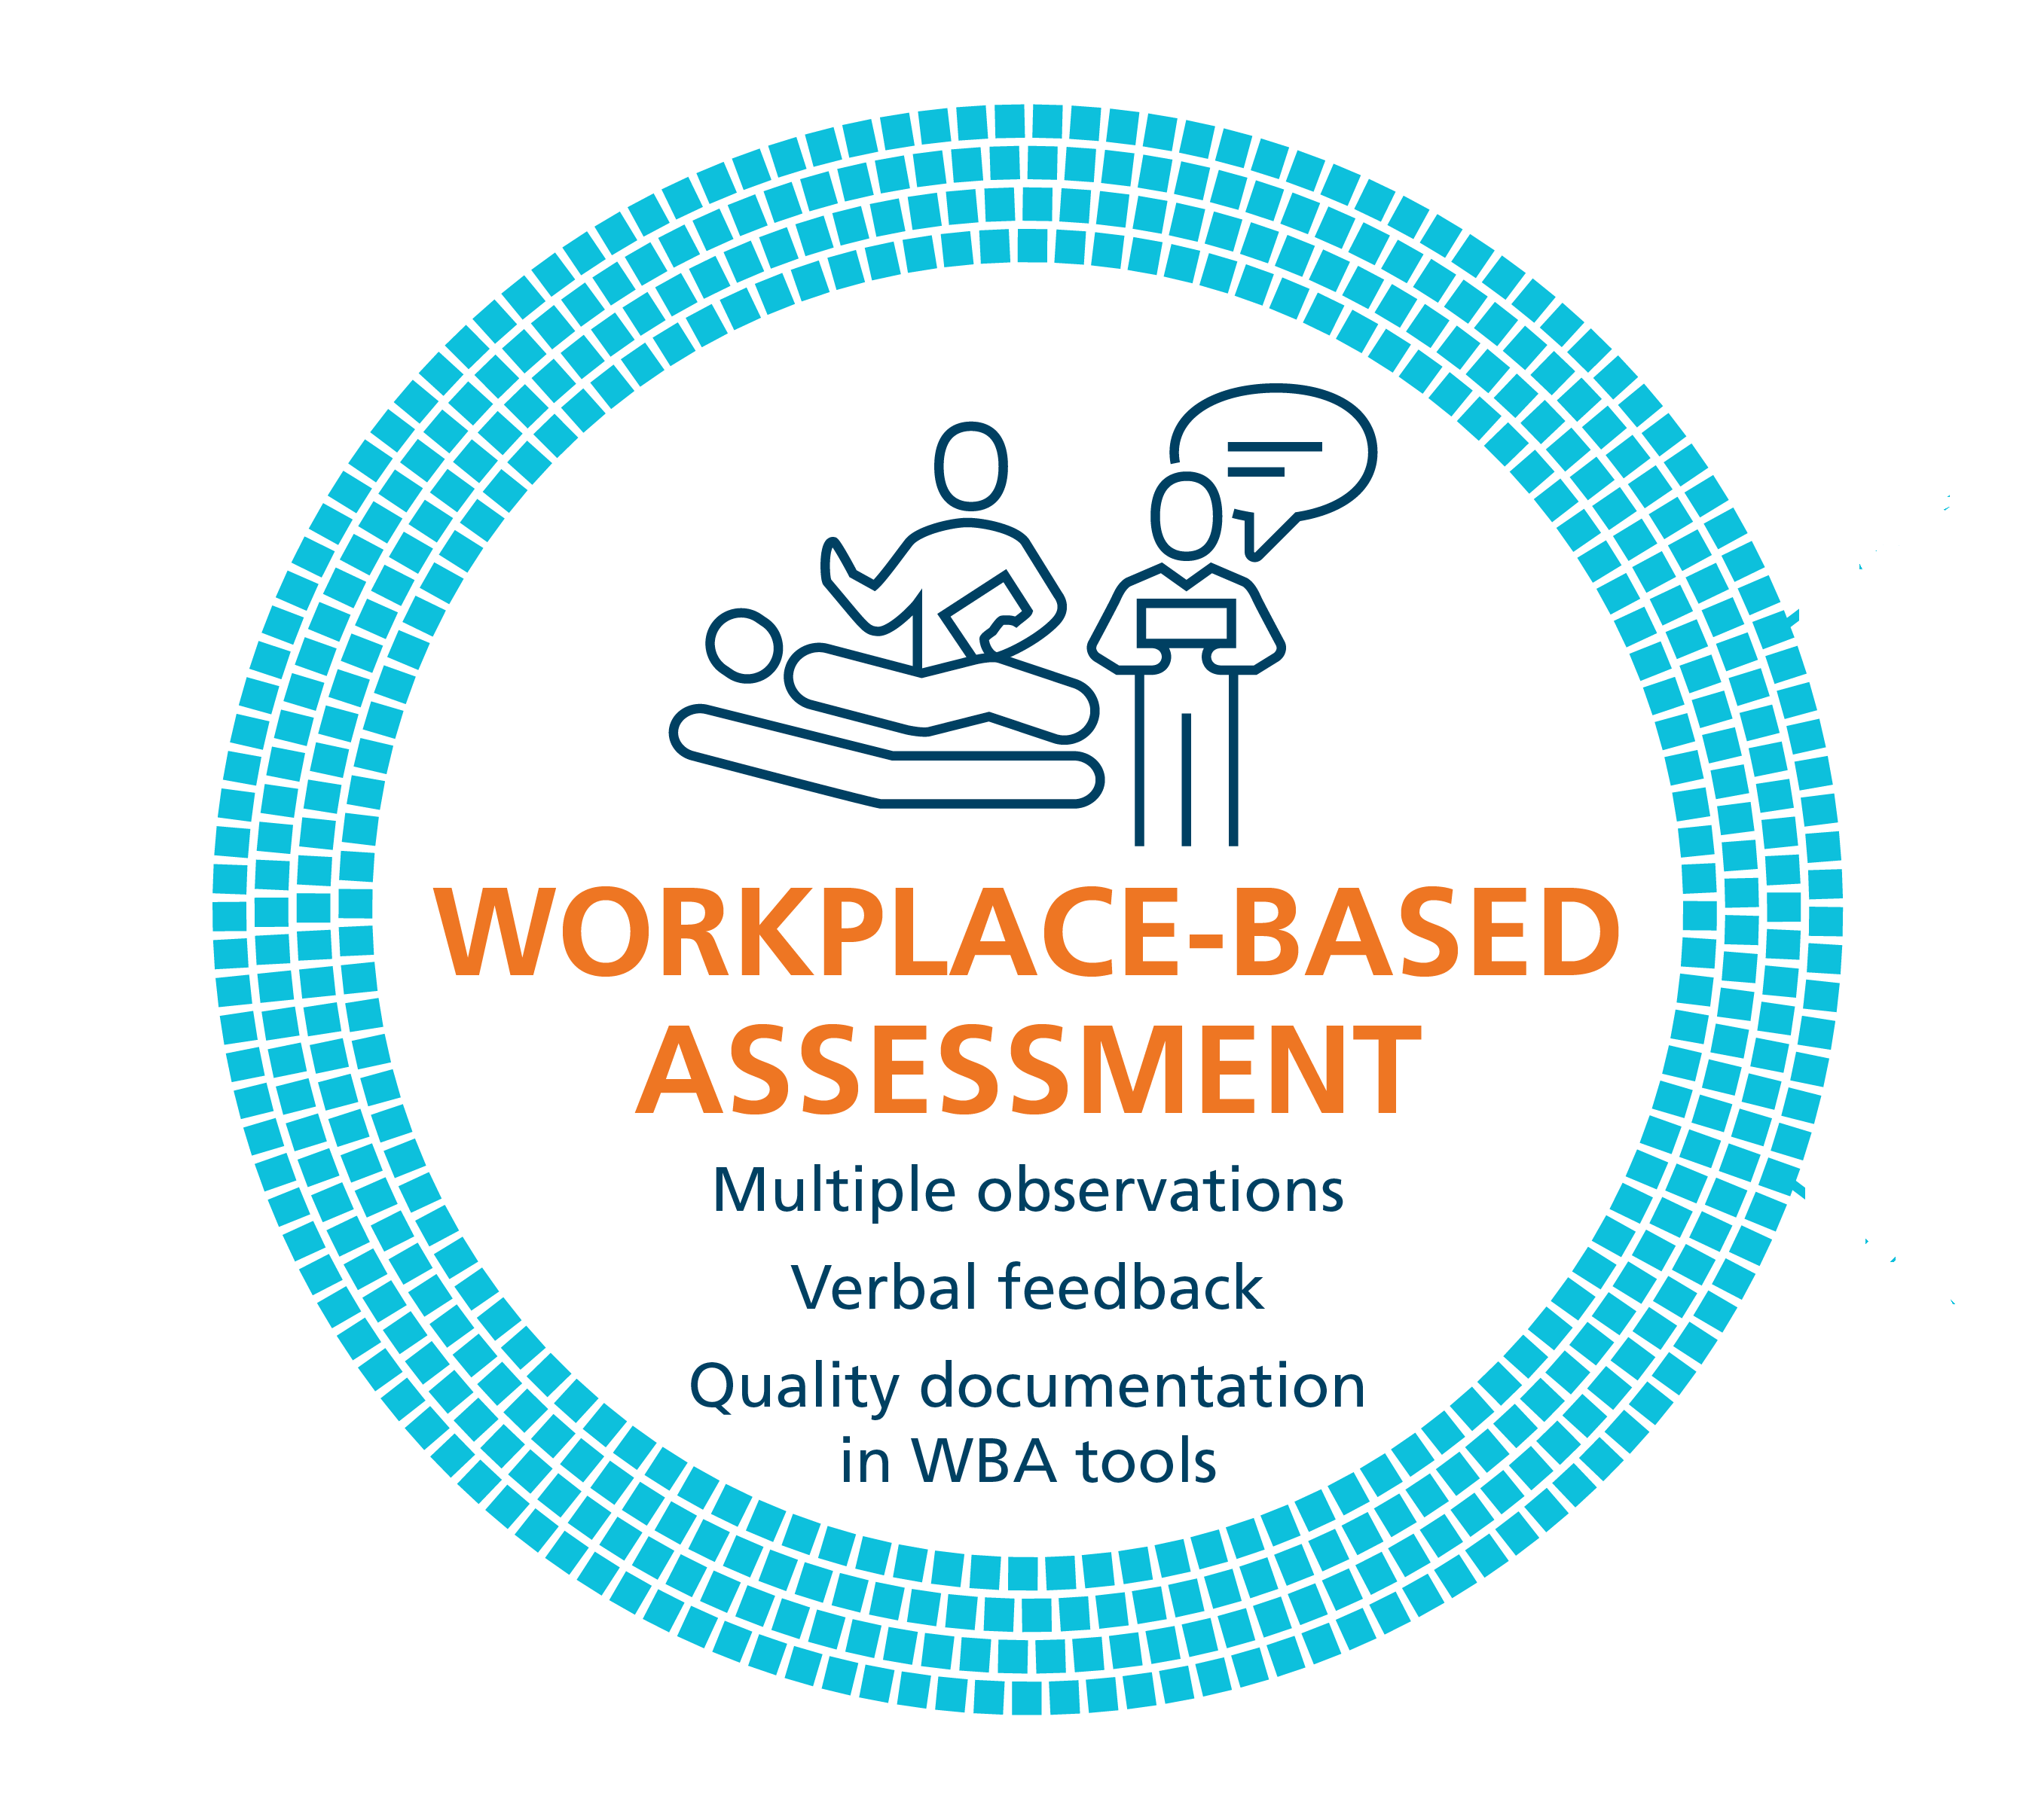
Workplace-based assessment: A process
RAPPORT
EXPECTATIONS
OBSERVE
COACHING
RECORD
RX-OCR
Notes:
This is the Royal College model for what we want clinical teachers to do with their trainees.
In CBD, frontline clinical teachers do not make judgements about learners. Instead, the expectation is that they observe trainees in practice and provide written and verbal feedback designed to promote learner growth. When the RX-OCR process is followed, there is tremendous value in the information given and its utility for the resident’s learning.
The steps in the process are:
1) R: Establishing educational “Rapport” between the resident and the clinician; an educational alliance or partnership;
2) X: Setting “eXpectations” for the particular clinical time period;
These initial steps need not take longer than a few minutes.
3) O: “Observing” some type of work that the resident does;
4) C: Engaging in a “Coaching conversation” for the purpose of improvement of that work (“coaching”);
5) R: “Record” a summary of the dialogue that occurred so that the resident can build a portfolio of observations demonstrating progress and areas to be improved. Feedback is documented in various workplace-based assessment (WBA) tools. Completing some WBA tools involves clinical teachers rating learners practice performance using retrospective supervision scales and detailed narrative descriptors.

Slide 8
Where does “assessment” fit?
RAPPORT
Establishing a relationship
EXPECTATIONS
Helps focus observation
OBSERVE
Make a decision about what you saw
Did they need any assistance from you to successfully complete the task?
If not, what would you say needs to improve, if anything?
COACHING (between clinician and resident)
Identify what was done well, what needs improvement, etc.
Provide some normative information
Provide direction as to how to improve
RECORD
Your “assessment of how it was performed
Independence is the standard (retrospective supervision scale)
Suggestions you gave to trainee for improvement
Notes:
This slide helps to explain how assessment fits into the model. The word “assessment” simply refers to the decision you made about the quality of the performance that you observed. It is in no way a summative judgment. Rather, you need to make a decision about whether something was well done or not in order to help coach them on how to improve.

Slide 9
Balancing assessment and coaching
Competence committees need assessment data in order to make resident progression decisions, but -
Coaching can also happen without assessment – there can be moments for learning and growth that do not include documentation for the competence committee
Program and competence committees should decide the quantity and frequency of required documented assessments versus undocumented coaching moments
For example, programs may decide on “coaching periods” versus “assessment periods”

Slide 10
Focus for today
Observation issues
Rating scales
Narrative observation
Notes:
These are the three topics that this slide deck covers.

Slide 11
Observation Issues

Slide 12
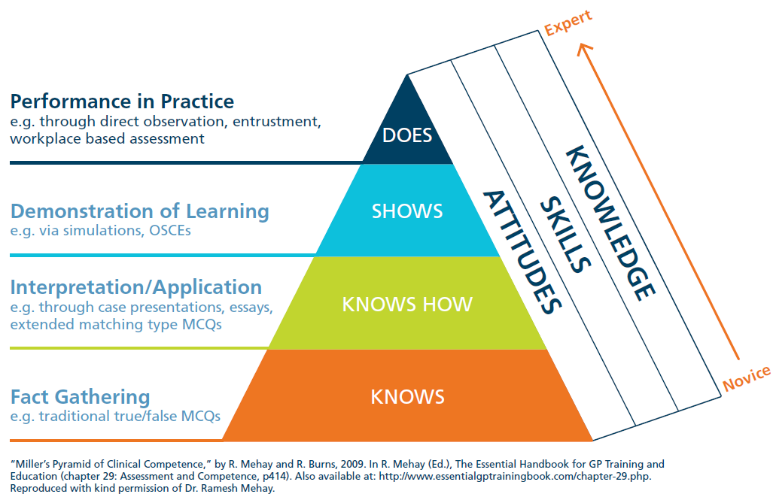
Major challenge
Notes:
This slide demonstrates that most of our commonly-used assessment methods do not get at what a trainee does on a typical clinical day. We need our faculty to understand the importance of assessing trainees in the real clinical environment so that we can ensure that they perform competently there.

Slide 13
Observation strategies
Orient the trainee to being observed
Two approaches:
Watch it all
Watch bits and pieces
Some aspect of history
Repeat physical exam
Provide the plan
Introduce concept to patient
“I’m a fly on the wall”
Define what you need to watch
Make a schedule to observe
Notes:
This slide discusses various options for observing trainees, particularly in a clinic or ward setting. It is important to discuss the option of watching an entire patient interaction versus choosing to see specific parts. Both have value. Determining what works best for your clinical teachers’ environments is key. If only typically watching parts of performance, then teachers must ensure that they eventually see all aspects that they need to for good assessment.

Slide 14
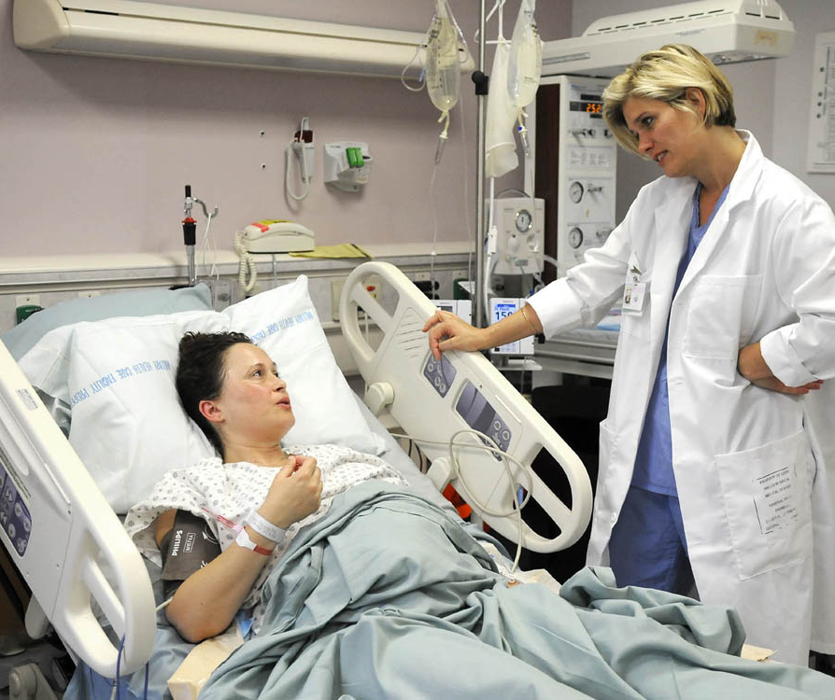
What about indirect observation?
Examples:
Interactions with other team members
“I really don’t like being on call with Dr. X”
Comments from patients and families
“She is wonderful… keep her!”
Ask them why
Follow-up questions when needed
Thank them for telling you
Notes:
Think of examples that are relevant to your clinical context and insert them here. When information is given to clinical teachers about their residents the first response should be “thank you for telling me”. Often though, their comments are not specific. You need to encourage clinical teachers to ask the follow-up questions so that they get at understanding the details of the comments.

Slide 15
What about indirect observation? (continued)
Inferences you make from clinical work
Case presentations
Chart review
Information you find out when you see patient
Discuss your observations with trainee
May include having them demonstrate technique, walk you through their reasoning, etc.
Assess their performance based on the above
Provide feedback
Notes:
Additional areas for indirect observation in your group’s clinical context should be reviewed. For example, you can infer something about their history taking and physical exam skills by the case presentations. After you check yourself, you will know if they were appropriate or not.

Slide 16
Rating scale anchors

Slide 17
Traditional rating scale anchors
1 – Consistently below expectations
2 – Sometimes below expectations
3 – Meets expectations
4 – Sometimes above expectations
5 – Consistently above expectations
What works? What does not work?
Notes:
The majority of ratings scales typically used for WBA tools use a scale such as this or one that rates from poor to excellent. Having your audience tell you what they like and dislike about these scales will get the conversation started about rating scales. Typically, people talk about the frustrations that they have with knowing what to expect so it is hard to interpret.

Slide 18
Newer rating scale anchors
Given the challenges with traditional anchors, newer ones were developed
Newer anchors describe the degree of supervision/help/assistance that the learner needed to complete the task
Research demonstrates that they work better
Notes:
There are several other tools that use these newer anchors. Please see the reference, “Rekman J, Gofton W, Dudek N, Gofton T, Hamstra S. Entrustability anchor scales: outlining their usefulness for clinical competency based assessment. Academic Medicine. 2016;91(2):186-190” for a thorough discussion and reference list.
An excellent study that is worth discussing in this type of session is “Crossley J, Johnson G, Booth J, Wade W. Good questions, good answers: construct-alignment improves the performance of workplace-based assessment scale. Medical Education. 2011;45:560-569”. In this study they changed the traditional rating scale anchors to align with increasing independence for three commonly used WBA tools. They demonstrated significantly increased reliability with the new anchors.

Slide 19
Example – Newer rating scale anchors
Ottawa Surgical Competency Operating Room Evaluation (O-SCORE) anchors
1 – “I had to do”
2 – “I had to talk them through”
3 – “I had to direct them from time to time”
4 – “I needed to be available just in case”
5 – “I did not need to be there”
Several tools have been developed using these anchors:
O-SCORE – Ottawa Surgical Competency Operating Room Evaluation
OCAT – Ottawa Clinic Assessment Tool
OBAT – Ontario Bronchoscopy Assessment Tool
O-EDShOT – Ottawa Emergency Department Shift Observation Tool
Royal College recommends use of the O-SCORE anchors given the evidence of validity
However, this is not a requirement provided that the scale chosen uses this style of anchor. The Competence Committee and program can decide which scale is used.
Notes:
O-SCORE reference is listed at the end of the presentation (Gofton et al., Academic Medicine 2012). References for the four tools listed are also at the end of the presentation.
Royal College accreditation surveyors will look for proof of assessment ratings but will not penalize a program for using their scale of choice.

Slide 20
Why do these scales seem to work?
Notes:
This section of the presentation highlights some of the theories as to why these scales are working better.

Slide 21
Entrustment
Supervising physicians understand that the goal is that trainees no longer require supervision to complete clinical tasks
At that point, we would entrust them to perform independently
Anchors that describe the amount of supervision/assistance that a trainee required are easier to use because they align with the well-understood goal of becoming capable of independence

Slide 22
What’s in a name?
Given that these newer tools use the construct of entrustment, they were termed “entrustability scales,” and were defined as
“behaviourally-anchored ordinal scales based on progression to competence”
Problem: The name led some faculty to think they were being asked to rate their level of entrustment when using these scales. This is understandable given the name, but inaccurate.
Data from these tools can be used to support entrustment decisions, but they do not rate the level of entrustment.

Slide 23
Retrospective versus prospective
Retrospective tools
Rate what has been done, not a level of entrustment
Data from retrospective tools can be used to support entrustment decisions
Entrustment can only be a prospective decision
“I entrust you to do this in the future”
It is possible to use a scale to describe what you would let the trainee do going forward - “Prospective entrustment-supervision scale”
It can also just be a yes/no answer - essentially, this is what happens at the Competence Committee level
Notes:
Reference (Ten Cate 2020).

Slide 24
Retrospective supervision scale
Term that should be used to describe the type of scale that the various WBA tools and EPA observation forms use in CBD
Emphasizes that we are asking supervisors to rate the performance that they just witnessed (retrospective)
The word ‘entrustment’ is removed to avoid any misunderstanding that the clinical supervisor is rating entrustment (they are not)
‘Supervision’ reminds raters that they are rating the amount of supervision/assistance/help that they provided to the trainee for that particular task
Notes:
Reference (Tavares 2022)

Slide 25
How to use these tools
Prepare residents for the different approach
Do not be afraid to assign the rating that describes the performance
Do NOT worry about the level of training
Focus on today’s performance
Do NOT worry about what this means for the future
Do not worry about how the resident will react to being told that they are not a “5”
Most know that they did not perform the task entirely on their own
Notes:
These are some key issues that need to be discussed. This is a “retrospective” assessment (i.e. how did whatever you just observed go). In no way, are you making a decision about their future potential to perform that activity. That decision rests with the Competence Committee. Also, remember to think about assistance not as just physical assistance (such as doing part of a procedure) but also any verbal guidance or direction (such as when discussing what the diagnosis or choosing the best management for the condition).

Slide 26
How to use these tools (continued)
What about situations where I do not see an entire EPA?
Common
Partial assessment is better than no assessment
Useful to know that they can do part of the EPA
Options
Complete part of the EPA rating form
Do only a narrative observation
Use another tool if your program has one
Discuss what the scale means in your context
Procedure versus non-procedure
Notes:
It is important to spend time discussing concerns with using a retrospective supervision scale in your clinical context.

Slide 27
Using different scales – Scenario 1
A PGY-2 trainee working in a clinic is functioning beyond what one would expect with respect to their physical exam skills for some, but not all, of the patients seen in this clinic. Some of the exam skills do not need any intervention from you, but on others you need to provide some guidance.
How would you rate their physical exam skills using each of the scales?
Notes:
Once possible approach to talking through the new scales is to use examples of resident performance and get the audience to choose the different ratings. You can write scenarios that make sense for your particular clinical context. Here are two examples.

Slide 28
Using different scales – Scenario 1 (continued)
Rating scale A
Rarely meets expectations
Inconsistently meets expectations
Meets expectations
Sometimes exceeds expectations
Consistently exceeds expectations
Rating scale B
Required complete guidance: “I had to do”
Able to perform, but required repeated direction: “I had to talk them through”
Some independence, but intermittent prompting required: “I had to direct them from time to time”
Independent for most things, but required assistance for nuances: “I had to be there just in case”
Complete independence: “I did not need to be there”
Notes:
Have people choose their ratings on each scale before you show the next slide.

Slide 29
Using different scales – Scenario 1 responses
Scale A – 4. Sometimes exceeds expectations
Scale B – 3. Some independence, but intermittent prompting required
Notes:
You may have some different answers for Scale A, but people generally agree that for Scale B, the resident is a 3.

Slide 30
Using different scales – Scenario 2
A PGY-4 trainee needs to perform procedure X. The resident is aware of sterile technique, and how the results will assist in further management. However, they required direction on patient positioning and land-marking, as well as the size of needle to use. You would have expected that a resident at their level would know and be able to complete these technical portions of the procedure.
How would you rate their technical performance on this procedure using each of the scales?

Slide 31
Using different scales – Scenario 2 (continued)
Rating scale A
Rarely meets expectations
Inconsistently meets expectations
Meets expectations
Sometimes exceeds expectations
Consistently exceeds expectations
Rating scale B
Required complete guidance: “I had to do”
Able to perform, but required repeated direction: “I had to talk them through”
Some independence, but intermittent prompting required: “I had to direct them from time to time”
Independent for most things, but required assistance for nuances: “I had to be there just in case”
Complete independence: “I did not need to be there”
Notes:
Have people choose their ratings before showing the next slide.

Slide 32
Using different scales – Scenario 2 responses
Scale A – 2. Inconsistently meets expectations
Scale B – 2. Able to perform, but requires repeated direction
Notes:
There are usually two points to make with this example. First, many people comment that their staff do not typically use the lower part of scale A (1s and 2s), even though they think they should.
The second point is that the anchor clearly describes why it should be a 2 in scale B. The language of it is often more acceptable to the resident than the language of the descriptor for a 2 in scale A.
If you have a rating tool that you are going to be using, this is a good time to introduce it. Remember your school may use the O-SCORE anchors or they may use another type of retrospective supervision scale.

Slide 33
Narrative observation
Notes:
Narrative observation is also referred to as qualitative assessment and written feedback.

Slide 34
Qualitative assessment
Misconception:
Subjective = Unreliable
Objective = Reliable
“Faculty need to recognize that numeric ratings are nothing more than a process to synthesize and then represent a composite judgement about a trainee.”
Holmboe et al., Academic Medicine, 2011.
Notes:
There is a common misconception in medical education that written comments are subjective and therefore unreliable, whereas a number on a rating scale is objective and therefore reliable.
This quote beautifully illustrates that when we choose a number on a rating scale, we typically started with words in our head to describe that performance and then decide what number to give it.

Slide 35
Qualitative assessment (continued)
More recently:
More emphasis on qualitative assessment
Some suggesting that narrative descriptions replace numerical ratings
Research demonstrates that a large portion of the usefulness of these methods is in the narrative (qualitative) part
Think about this clinically:
“My pain is a 6 out of 10.” versus “My pain is constant, burning, and interfering with my ability to wear my prosthesis.”
Which is more useful?
Notes:
It is helpful to explain the usefulness of words by having faculty consider a clinical example such as a description of pain. Although numbers can help us, one patient’s “6” is often not the same as another patient’s “6”. It also gives us less information about what we can do to help the pain. Changing the example to a clinical one that makes sense for your context is advisable.

Slide 36
Words and not numbers
Rich narrative observations of performance:
Enhance the formative function
Provides the information required for guided reflection
Are required for defensible decisions in summative assessments
Can be compiled
“Reliability” is obtained with adequate sampling
Notes:
The literature provides us with information regarding the importance of narrative observations. These are the details that we need to help guide our trainees towards independent practice.

Slide 37
What do you think of this comment?
“She’s great – very confident, thorough, at expected level of training or beyond. Clinically very good, no gaps.”
Notes:
Have a discussion about an example of a comment that discuss good performance. Positive comments are a good place to start as they usually are quite vague.
You can use one from your own assessments. This is often a good choice as faculty like seeing comments that have been used in their program so that they are context-specific.

Slide 38
How could you improve it?
Notes:
Ask them how they could make it better. Hopefully, they will come up with some of the key features of high-quality comments from the literature, which are provided on the next slide.

Slide 39
High-quality comments
Justify the rating
Have specific examples
Provide recommendations for improving performance
Are written in a supportive manner
Are detailed enough for an independent reviewer to understand the issues
Notes:
The literature is quite clear on what makes a useful comment:
If the comments are written as part of an assessment tool that uses a rating scale, then they should match the rating. You do not want to have to figure out which one is actually true.
Specifics are key. You need to be very clear about what you are describing. Using the specific description of what you observed will also help the trainee to understand the basis for your comments.
Recommendations for how to get better make a good comment great. The trainee then knows how to improve.
Most faculty never have an issue with this. However, sometimes overgeneralized statements get written down that do not support learning. For example, in observing a trainee who performed poorly when assessing a geriatric patient, the staff might think “You obviously are uncomfortable with older patients.” This is okay to think but should never be verbalized or written down. It is not useful feedback. Sticking to describing what you saw and how it compares to what you want to see is a much better way to support a trainee’s improvement. The “lazy example” provided a bit later in the presentation outlines this further.
This is key. Daily assessments will be fed to the Competence Committee for them to review and use to make determinations regarding the resident’s progress. Those committee members should not need to phone the writer of the comment for further explanation. This is inefficient. The comment should speak for itself.

Slide 40
How to write descriptive comments
Transform your verbal feedback into written comments
Focus on behaviour – not attitudes
Be specific
When possible, discuss the outcome
Note their response to the feedback
Write it down
Notes:
Written comments should just be a summary of the verbal feedback that you provided to the trainee about their performance. Verbal feedback and written feedback should focus on behaviours, be specific and discuss the impact of their actions/inactions. The trainee’s response to verbal feedback is also a very useful thing to note. If you are working with a trainee that you provided feedback to in the past and you now have a chance to see them act on that feedback it is really useful for a Competence Committee to know that trainees accept and act on feedback.

Slide 41
Behaviours – not attitudes
Attitude
Lazy
Behaviours (and outcomes)
Consistently late (staff work late to accommodate)
Does not follow up on tests (missed critical issue)
Does not answer pages (called staff/other resident)
Does not do assigned readings (staff wastes time in teaching session)
Notes:
It is useful to spend time working on what it meant by focusing your feedback on behaviours and not attitudes. The example given here is for “lazy”. You might also consider something like “rude” or “unmotivated”. Essentially these are all descriptions of various attitudes that many of us would define slightly differently and that many residents would take offense to if you said or wrote that about them. My advice is “It’s okay to think it but not okay to say or write it”. Rather what we need to ask ourselves in this situation is “why am I thinking this?” Usually if you do, you will come up with a list of things that they did or did not do. These are the behaviours and these should be the focus of your feedback.

Slide 42
Narrative observation form
Describe one aspect of performance that was done well
Was this done at the level of “competent for independent practice?”
Yes
Not yet
Describe one aspect of performance that could improve
What are your suggestions for how the resident could address the area of performance to improve?
Notes:
The Narrative Observation Form (previously called Form 4) is a tool designed to capture purely narrative feedback. It is useful to discuss with your faculty that you are looking for areas of good performance and areas for improvement the majority of the time. Certainly, there will be times when you want to focus on one or the other, but in general if you encourage faculty to think “one and one” for each time they work with a trainee, this will help them to organize their feedback.
Typically, you would not use this tool to assess an entire EPA, but you might be using it to document a piece of an EPA. If so, it is useful for the faculty to state whether or not the good comment describes a performance that would be at the level of independent practice or not.
Of course, as has been mentioned before, the area for improvement should be linked to a specific suggestion for how the trainee is to achieve this.

Slide 43
Okay comments
“Responds well to feedback”
“Communication skills need work”
“Read more”
“Great case presentations”
Notes:
Have your group take time to attempt to write better versions of these ‘okay’ comments. The next slide offers some suggestions.
You can use examples from your own context.

Slide 44
Better comments
“Responds positively to feedback. For example, noted that you missed a quads lag by not first checking passive ROM of the knee. Reviewed proper technical for quads testing. On observation at a later point during the clinic you had altered your physical exam appropriately.”
“Tendency to use to much medical jargon when explaining issues to patients. For example, in the patient with an abnormal lesion on the chest x-ray, you said “It could be an infiltrate, a granuloma, or a malignancy.”
“Focus anatomy reading on the brachial plexus – you need to be able to draw the plexus out so that the neurological lesions can be mapped on the plexus.”
“Case presentations in clinic are succinct and include all relevant info. For example, in the patient with depression and back pain, you were able to focus on the issues relevant to the question asked by the referring doctor in presenting the case.”

Slide 45
Practice exercise 1
Think of a resident that you recently worked with
What verbal feedback did you give them?
Turn that feedback into a written comment and share it with a person in the room who is not in your specialty
Do they understand the comment?
Does it seem like a useful comment? Why or why not?
Discuss with the whole group
Notes:
This is a sample exercise that you can do with your group to get them practicing writing comments.

Slide 46
Practice exercise 2
Think of a resident that you recently worked with that you noted an area for improvement
Write it in a comment and include your suggestion for how they should address the area for improvement
Share it with a person in the room who is not in your specialty
Do they understand the comment and suggestion?
Does it seem like a useful comment and suggestion? Why or why not?
Discuss with the whole group
Notes:
Another exercise to get the group thinking about how to write suggestions for improvement linked to their areas for improvement.

Slide 47
Summary
Need to watch performance and provide verbal feedback
Retrospective supervision scales demonstrate promise with increased evidence for validity compared to tools with more traditional rating scale anchors
Verbal feedback is the basis of good written assessment
Good narrative assessment
includes specific, behaviour-based comments that include examples
is the key step to dealing with poor performance
can guide further training
Notes:
Sum up your talk by focusing on the points that are most key for your group. These may differ depending on where your audience is at regarding these topics

Slide 48
Questions?
Notes:
Ask them how they could make it better. Hopefully, they will come up with some of the key features of high-quality comments from the literature, which are provided on the next slide.

Slide 49
Thank You
royalcollege.ca • collegeroyal.ca
Stay informed during an emergency crisis.royalcollege.ca • @Royal_College

Slide 50
References, page 1
Albanese M. Rating educational quality: factors in the erosion of professional standards. Academic Medicine 1999;74(6):652-658.
Cheung WJ, Bhanji F, Gofton W, Hall AK, Karpinski J, Richardson D, Frank JR, Dudek N. Design and Implementation of a National Program of Assessment Model – Integrating Entrustable Professional Activity Assessments in Canadian Specialist Postgraduate Medical Education. Perspectives on Medical Education. 2024; 13(1): 44–55.
Cheung WJ, Gofton W, Wood T, Duffy M, Dewhirst S, Dudek N. The Ottawa Emergency Department Shift Observation Tool (O-EDShOT): A new tool for assessing resident competence in the emergency department. AEM Education and Training. 2020;4(4):359–68.
Cohen GS, Blumberg P, Ryan NC, Sullivan PL. Do final grades reflect written qualitative evaluations of student performance? Teaching & Learning in Medicine 1993;5(1):10-15.
Crossley J, Johnson G, Booth J, Wade W. Good questions, good answers: construct-alignment improves the performance of workplace-based assessment scale. Medical Education. 2011;45:560-569.
Crossley J, Jolly B. Making sense of workplace-based assessment: ask the right questions, in the right way, about the right things, of the right people. Medical Education 2012;46:28-37.

Slide 51
References, page 2
Driessen E et al. The use of qualitative research criteria for portfolio assessment as an alternative to reliability evaluation: a case study. Medical Education 2005;39:214-220.
Dudek NL, Marks MB & Regehr G. Failure to fail – the perspectives of clinical supervisors. Academic Medicine 2005;80(10):S84-87.
Dudek NL, Marks MB & Regehr G. Reluctance to fail poorly performing residents – explanations and potential solutions. ACGME Bulletin April 2006;45-48.
Dudek N, Marks M, Lee C & Wood T. Assessing the quality of supervisors’ completed clinical evaluation reports. Medical Education 2008;42:816-22.
Dudek NL, Marks MB, Wood TJ, Dojeiji S, Bandiera G, Hatala R, Cooke L, Sadownik L. Quality evaluation reports – can a faculty development program make a difference? Medical Teacher 2012:34(11):e725-e731.
Dudek N, Marks M, Dojeiji S. Completing a quality evaluation report – what clinical supervisors need to know - a faculty development workshop. MedEdPORTAL; 2013. Available from: www.mededportal.org/publication/9320

Slide 52
References, page 3
Dudek NL, Dojeiji S. Twelve tips for completing quality in-training evaluation reports. Medical Teacher 2014:36(12):1038-1042.
Gofton W, Dudek N, Wood T, Balaa F, Hamstra S. The Ottawa Surgical Competency Operating Room Evaluation (O-SCORE): a tool to assess surgical competence. Academic Medicine 2012;87:1401-1407
Gray JD. Global rating scales in residency education. Academic Medicine 1996 Jan;71(1 Suppl):S55-61
Halman S, Baird A, Rekman J, Wood TJ, Gofton W, Dudek NL. Implementation of the ottawa clinic assessment tool (OCAT) in internal medicine. Canadian Conference on Medical Education, 2017.
Hatala R, Norman GR. In-training evaluation during an internal medicine clerkship. Academic Medicine 1999 Oct;74(10 Suppl):S118-20.
Hauer KE, Homlboe ES, Kogan JR. Twelve tips for implementing tools for direct observation of medical trainees’ clinical skills during patient encounters. Medical Teacher 2001;33:27-33.
Hewson MG, Little ML. Giving feedback in medical education: verification of recommended techniques. Journal of General Internal Medicine 1998;13:111-116.

Slide 53
References, page 4
Holmboe ES, et al. Faculty development in assessment: the missing link in competency-based medical education. Academic Medicine 2011;86(4):460-467.
Kassebaum DG, Eaglen RH. Shortcomings in the evaluation of students’ clinical skills and behaviors in medical school. Academic Medicine 1999 Jul;74(7):842-849.
Speer AJ, Solomon DJ, Ainsworth MA. An innovative evaluation method in an internal medicine clerkship. Academic Medicine 1996 Jan;71(1 Suppl):S76-S78.
Rekman J, Gofton W, Dudek N, Gofton T, Hamstra S. Entrustability anchor scales: outlining their usefulness for clinical competency based assessment. Academic Medicine 2016;91(2):186-190.
Rekman J, Hamstra S, Dudek N, Wood T, Seabrook C, Gofton W. A New Instrument for Assessing Resident Competence in Surgical Clinic: The Ottawa Clinic Assessment Tool (OCAT). Journal of Surgical Education 2016;73(4):575-582.
Regehr G, Bogo M, Regehr C, Power R. Can we build a better mousetrap? Improving the measures of practice performance in the field practicum. Journal of Social Work Education 2007;43:327-343.
Regehr & Eva. Self-assessment, Self-direction, and the Self-regulating Professional. Clinical Orthopedics and Related Research 2006;449:34-38

Slide 54
References, page 5
Rolfe I, McPherson J. Formative assessment; how am I doing? Lancet 1995;345:837-839.
Sargeant J, Mann K. Feedback in medical education: skills for improving learner performance. In: Cantillon P, Wood D, editors. ABC of Learning and Teaching in Medicine. Oxford: Blackwell Publishing Ltd.; 2010.
Tavares W, Gofton W, Bhanji F, Dudek N. Reframing the O-SCORE as a “Retrospective Supervision Scale” Using Validity Theory. Journal of Graduate Medical Education. 2022; 14 (1): 22–24.
Ten Cate O, Scheele F. Competency-based postgraduate training: can we bridge the gap between theory and clinical practice? Academic Medicine 2007;6:542-547.
Ten Cate O, Schwartz A, Chen HC. Assessing trainees and making entrustment decisions: on the nature and use of entrustment-supervision scales. Acad Med. 2020;95(11):1662–1669.
Turnbull J, Gray J, MacFadyen J. Improving in-training evaluation programs. Journal of General Internal Medicine 1998;13:317-323.
Warm et, Mathis B, Held J, Pai S, Tolentino J, Ashbrook L, Lee C, Lee D, Wood S, Fichtenbaum C, Schauer D, Munyon R, Mueller C. Entrustment and mapping of observable practice activities for resident assessment. Journal of General Internal Medicine 2014; 29(8):1177-1182

Slide 55
References, page 6
Watling CJ. Unfulfilled promise, untapped potential: feedback at the crossroads. Medical Teacher 2014;36:692-697.
Weller J, Jones A, Merry A, Jolly B, Saunders D. Investigation of trainee and specialist reactions to the mini-Clinical Evaluation Exercise in anesthesia: implications for implementation British Journal of Anaesthesia 2014;103:524-536.
Voduc N, Dudek N, Parker CM, Sharma KB, Wood TJ. Development and validation of a bronchoscopy competence assessment tool in a clinical setting. Annals of the American Thoracic Society 2016;13(4):495-501.

Slide 56
Images
Slide # 11 “Miller’s Pyramid of Clinical Competence,” by R. Mehay and R. Burns, 2009. In R. Mehay (Ed.), The Essential Handbook for GP Training and Education (chapter 29: Assessment and Competence, p414). Also available at: http://www.essentialgptrainingbook.com/chapter-29.php.
Slide # 39 – Title: Logo - Feedback for future learning ; Author: Glasgow Caledonian University Source: www.gcu.ac.uk/futureelearning License: Permission from Glasgow Caledonian University (Feedback for future learning project)
Slide # 40 – Title: Lazy Resident ; Author: Shanghai killer whale; From Wikimedia Commons Licensed under CC 3.0 Unported license.

