Slide 1
How to use this slide deck
This presentation has been developed to help you to prepare your residents for CBD.
Significant content has been included to assist presenters who may be unfamiliar with CBD. You may edit the presentation to reflect the most relevant slides for residents in your discipline.
This presentation must be customized. You will need to:
  Insert your discipline or University where appropriate
  Introduce local curriculum
  Replace the cartoons on slides 32-34 with cartoons or pictures relevant to your discipline
  Include examples of EPAs and milestones from your discipline
  Highlight your local assessment plan and forms
  Prepare to demonstrate the electronic platform that your residents will use
  Highlight local support for residents
Share and/or modify these slides as needed but source the Royal College. All text and logos contained herein are the property of Royal College of Physicians and Surgeons of Canada.
Questions? Email cbd@royalcollege.ca

Slide 2
READY-TO-TEACH CBD
Welcome to (insert your discipline)
A resident’s orientation to CBD
AUTHORS:
ACKNOWLEDGMENT:
DATE:
Name
Name
Date
Notes:
The “Introduction to Competence Committees” workshop is designed to be delivered in 90 minutes. If you would like to deliver it in 1 hour or less, you can choose to take a flipped classroom approach and send some of the didactic materials ahead of the workshop for review, which will allow you to focus on the Case Practice at the end of the workshop.
The workshop may be delivered face-to-face or virtually. The slide notes include instructions for modifying for virtual delivery throughout. FOR VIRTUAL DELIVERY: You will need access to video conferencing platform that has the ability to create breakout rooms. See “How to Teach Virtually” (http://www.royalcollege.ca/rcsite/documents/canmeds/rc-virtual-teaching-e.pdf) for best practices, as well as a comparison of several video conferencing tools.
There is a more advanced workshop called “Running a Competence Committee” that you may choose to deliver in follow-up to this introduction.
Detailed notes are included to assist presenters and viewers who may be unfamiliar with some of these concepts. If you are presenting this deck, you are encouraged to edit the presentation to reflect the most relevant slides for your audience and purpose. You are encouraged to share and/or modify these slides as needed, but please source the Royal College. All text and logos contained herein are the property of the Royal College of Physicians and Surgeons of Canada.
Questions? Email cbd@royalcollege.ca

Slide 3
Acknowledgements
Special thanks to Adelle R. Atkinson, MD, FRCP(C) in the development of this workshop
How to cite these slides: Atkinson, A.R.(2020). A Resident’s orientation to CBD. The Royal College of Physicians and Surgeons of Canada. Available at Royal College of Physicians and Surgeons of Canada. [insert link once available]

Slide 4
Goals and Objectives
By the end of this session you will be able to:
  Explain to a colleague what CBD is and the rationale for its use in your medical training
  Describe the CBD approach to medical training, specifically in Paediatrics
  Be able to define some new terms:
    EPA
    Milestones
    Work-based assessment
  Understand your role as a resident in a CBD world.
  Review some experiences of early cohort residents and understand the challenges.

Slide 5

The biggest change in medical education in………
Notes:
This is the biggest change to medical education in 100 years, since the Flexner report.
Once in a lifetime opportunity to be involved as it roles out.

Slide 6

But why change?
This Photo by Unknown Author is licensed under CC BY-SA-NC
Notes:
Canada has a great training system, but we can do better
We need to get away from the “time spent” model, and be more explicit about what our graduates need to achieve throughout the various stages of training

Slide 7

Competence ≠ time spent
This Photo by Unknown Author is licensed under CC BY
Notes:
This is the move to ensure competence, as opposed to “time spent” on a particular clinical rotation. One does not = the other.
CBD also incorporates the notion of assessment FOR learning, as opposed to assessment OF learning
The traditional training model is time-based (a "tea-steeping" model, in which the student "steeps" in an educational program for a historically determined fixed time period to become a successful practitioner)

Slide 8
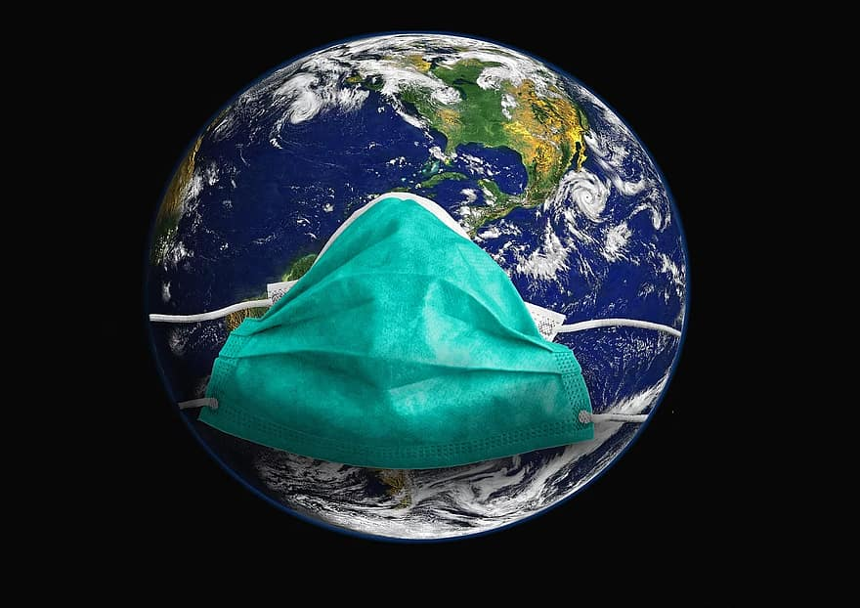
This photo by Unknown Author is licensed under Pikist.com (public domain)
Notes:
Acknowledge the pandemic:
Tell them how you responded for your resident group
Tell them what you learned
Tell them what is going to change moving forward due to lessons learned (ie: more virtual teaching?)

Slide 9
What is CBME and what is CBD?

Slide 10
CBME
Competence by Design (CBD) is the Royal College’s multi-year, medical education, transformational change initiative aimed at implementing a CBME approach to education and assessment to residency training and specialty practice in Canada.
The goal of CBD is to enhance patient care by improving learning and assessment across the continuum (from residency to retirement), ensuring physicians have the skills and behaviours required to continuously meet evolving patient needs.

Slide 11
CBD
Competence by Design (CBD) is the Royal College’s multi-year, medical education, transformational change initiative aimed at implementing a CBME approach to education and assessment to residency training and specialty practice in Canada.
The goal of CBD is to enhance patient care by improving learning and assessment across the continuum (from residency to retirement), ensuring physicians have the skills and behaviours required to continuously meet evolving patient needs.

Slide 12
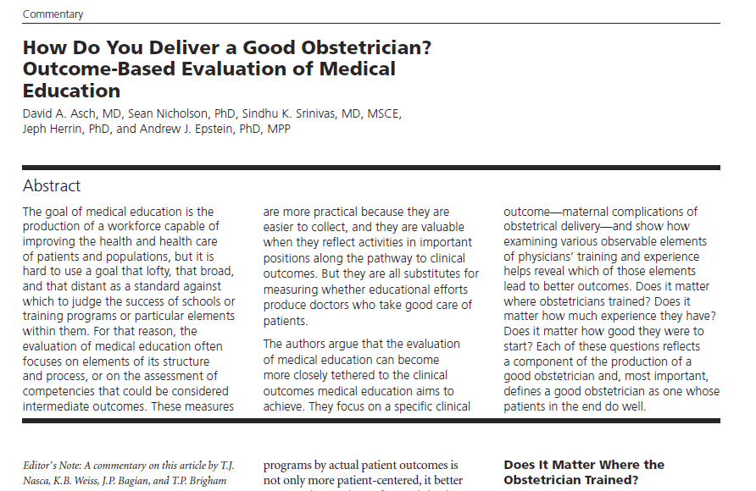
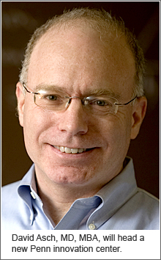
Why change?
Evidence suggests that where a physician trains determines the level of care that physician will provide throughout his/her career.
Notes:
David Ash’s seminal study showed that in OB/GYN, patient outcomes could be directly correlated with where training occurred
David showed that complication rates after training, did improve with experience, but at a rate that was dictated by where one trained. For example: if you trained at program “x”, your trajectory of improved complication rates followed a curve, but that curve was different if you trained at program “Y”, (lets say for the sake of argument better than “X”) and while both complication rates improved, ”X” was never able to reach as low as “Y”.
So early experiences in training matter, how you are taught matters, curriculum matters, feedback and coaching matter.

Slide 13
How does CBD benefit learners?
More frequent assessment and meaningful feedback from faculty
Well-defined learning paths and clarity around the competencies needed to progress to the next stages of training
A learning path that focuses on personal development
Easier transitions between stages
Empowerment of residents in training
The chance to prepare for independent practice by honing skills and working more independently during the final stage of residency
Notes:
More frequent assessments means they are each ”lower stake”
Should be clear to the learners what they need to achieve, they will be more invested in their learning

Slide 14
Stages, EPAs and Milestones

Slide 15
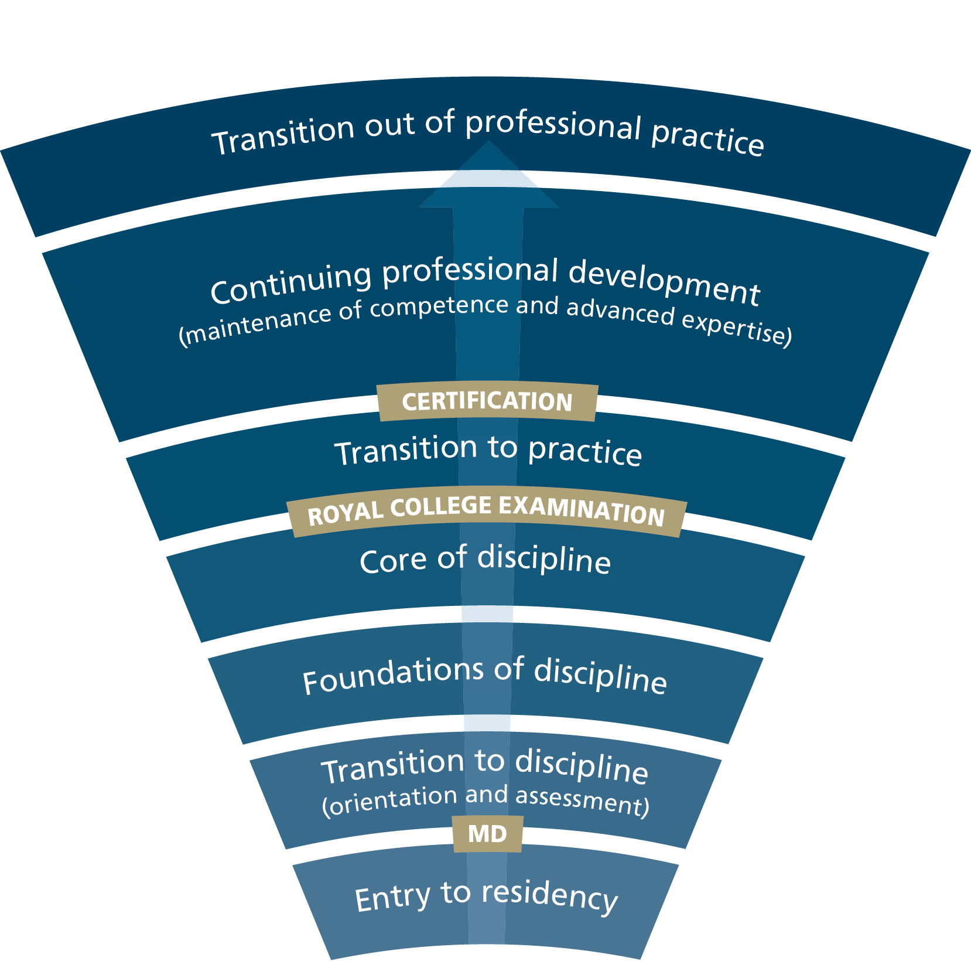
CBD Stages
Notes:
Review with residents the 4 stages of training, reminding them that life-long learning is the goal
This would be a good time to speak to the length of each stage in your specific discipline

Slide 16
What is an EPA?
Entrustable Professional Activity (EPA) is a task in the clinical setting that may be delegated to a resident by their supervisor once sufficient competence has been demonstrated.
  Typically, each EPA integrates multiple competencies/milestones
  EPAs are and it is generally used for overall assessment.
Example:
  (Insert specialty example here of an EPA title)

Slide 17

What is a milestone?
A CanMEDS milestone is an observable marker of an individual's ability along a developmental continuum, which is used for planning and teaching
Eg. (Insert a specialty specific example here)
This Photo by Unknown Author is licensed under CC BY-NC-ND
Notes:
Milestones are really helpful for those who design curriculum, and those who assess learners as they are provide that needed detail

Slide 18
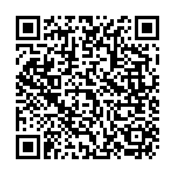
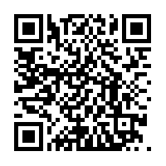
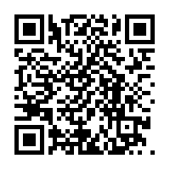
What is the difference
The key difference between EPAs and milestones is that EPAs are the tasks or activities that must be accomplished, whereas milestones are the abilities of the individual.
What is an EPA? (1.17 mins) Understanding Entrustable Professional Activities (EPAs) (5.11 mins)
EPAs - Dr. Lisa Bahrey U of T Anaesthesia (3.47 mins)
Notes:
Here are three videos that will help to understand the concept of EPAs

Slide 19

How does CanMEDS fit into all of this?
EPAs and milestones are mapped onto the CanMEDS competency framework
Intrinsic (non-medical expert) roles are taught and assessed
  Communicator
  Collaborator
  Leader
  Health advocate
  Scholar
  Professional

Slide 20
An example of an EPA and milestones
Insert example from one of the stages in your specialty with the EPA and milestones together

Slide 21
Milestone
Milestone
Milestone
EPA
Typically, each
EPA integrates
multiple milestones.
Notes:
As each EPA is taught and learnt, residents will progress through the stages of training

Slide 22
Assessment in CBD

Slide 23
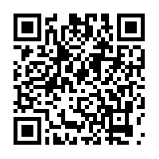
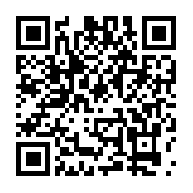
What is workplace-based assessment?
What is WBA? (1.51 mins)
How will assessment work in CBD work? (1.52 mins)

Slide 24




How Will it Work? Learner
Plan learning
Views Learning Plan EPAs & milestones
Selects training activities
Requests observation
from Observer
Participates in learning
Seeks feedback
Works with Observer & peers
Reflects on learning
Contributes evidence
of learning
Learner
Reflects on observations
& learnings
Supported
by technology
Participates in observation encounter
Notes:
For a learner, assessment will flow as follows:
Plan learning
This occurs in a macro (rotational) view and micro (daily) view.
Views Learning Plan EPAs & milestones as part of the day or rotation.
Selects observation opportunities.
Works with supervisor to find opportunities.
Participates in the encounter
Works with supervisor, peers, and often, the patient.
Exchange feedback
The resident self-assesses (i.e., reflects on learning).
The supervisor provides specific constructive feedback for learning based on evidence from the encounter and the design of the RCEPA.
Record observation
Not all observations are recorded.
This could be in an ePortfolio or other means of technology.

Slide 25
How Will it Work? Observer
Supports learning
Works with learners
Provides feedback an coaching
Contributes narrative
Reviews evidence
Prepares for observation
Reviews and accepts requests for observation
Reviews EPAs and milestones
Observer
Supported
by technology
Participates in observation encounter
Evaluates EPA/milestones & records data via technology
Notes:
For the observer assessment will flow like this
Supports learning
Works with learners
Contributes to narrative
Review evidence of learning
Prepares for observation
Reviews and accepts observation requests
Reviews EPAs and milestones
Participates in observation encounter
Works with learner, and often, the patient.
Provides feedback
The observer provides specific constructive feedback for learning based on evidence from the encounter and the design of the RCEPA.
Record observation
Not all observations are recorded.
This could be in an ePortfolio or other means of technology.

Slide 26

How Will it Work? Learner and Observer
Learner
Plan learning
Views Learning Plan EPAs & milestones
Selects training activities
Requests observation
from Observer
Participates in learning
Works with Observer & peers
Reflects on learning
Contributes evidence of learning
Reflects on observations & learnings
Supported
by technology
Observer
Supports learning
Works with learners
Contributes narrative
Reviews evidence
Prepares for observation
Reviews and accepts requests
for observation
Reviews EPAs and milestones
Observation encounter
Supported
by technology
Evaluates EPA/milestones & records data via technology
Notes:
Holistic view

Slide 27

Contextual variables
This photo by Unknown Author is licensed under Wallpaper Flare.com (public domain)

Slide 28
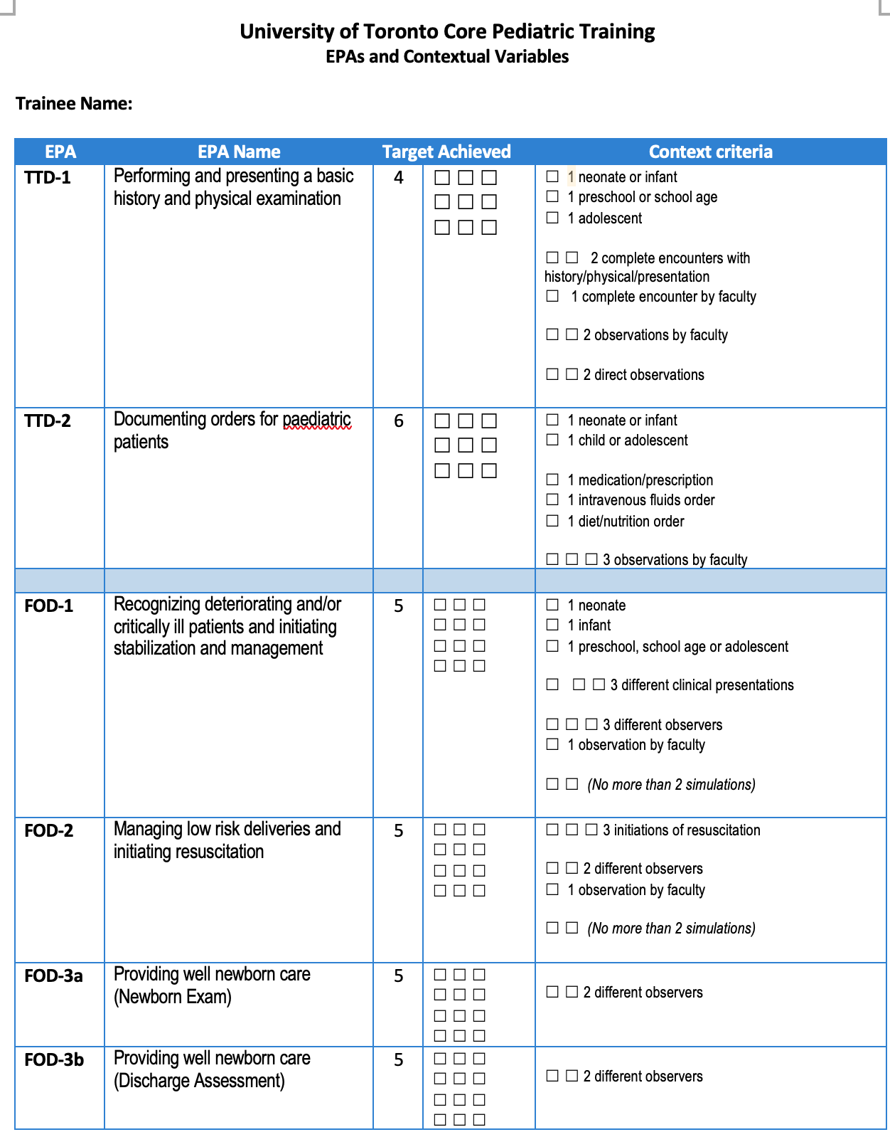

Slide 29
EPA observation forms
EPA observation forms may look different from program to program, but they all include:
  An entrustability scale (a rating scale with entrustment anchors) so the observer can provide an impression of your overall competence in a specific activity
  Space for narrative comments to encourage coaching feedback that is specific, actionable and timely

Slide 30

Day in the Life of an Observer
Clear evaluation path reduces need to teach and evaluate everything all the time.
Flexible timeframes ensures you have the availability to teach and the resident has the time to learn.
More frequent formative assessments and meaningful feedback foster performance improvements.
Notes:
What does a morning in clinic look like in our specialty?
The morning in a clinic will appear similar to the current setup, however assessments will be directed and specific. Instead of taking responsibility for the entire teaching and assessment of the resident, the clinical teacher is assigned one EPA. Like the current system, the clinical teacher takes opportunities throughout to discuss and teach the resident as they appear, balancing assessment and teaching. The morning could go like this:
You arrive at clinic and greet your nurse, clerk, and trainee. Upon reviewing your schedule, you briefly review the RCEPA that you are to assess with your trainee.
You notice you are double-booked in one slot and discuss with the trainee how she can take on one of the bookings.
Together, you identify an experience in which you can observe the resident complete the assigned EPA.
You begin seeing patients, meeting intermittently with the trainee to review decisions and directions.
You meet with the resident to observe the planned EPA, seeing the patient.
You provide feedback and record your observations via the assessment technology
You receive results from a patient coming into the clinic. This is bad news that you must break to the patient and his family.
You flag the resident to join you to experience this difficult conversation.
You continue to meet with patients, arranging home care, adjusting chemotherapy orders, and making changes where necessary.
Your trainee approaches you with a question. You take a moment to respond and check for understanding.
The trainee asks for you to observe and provide some additional feedback.

Slide 31


What Happens to the Observation Data?
Program Director
Guides learning
Meets with learners regularly
Assigns EPAs to Observer
Reviews learner progress using technology
Reviews program status
Reviews program data and investigates issues
Prepares for Competence Committee meetings
Supported
by technology
Assess overall achievement of EPAs & milestones
Review learner EPAs/milestones
Approve changes to learner status
  Promote learner to next stage of training
  Request Royal College certification
  Modify Learner program plan
  Monitor overall progress of learner
Provides group decision process rather than single summative assessment
Competence Committee
Supported
by technology
Notes:
Now I’m sure many of you are asking what happens to the data that is collected by the Observer
As you know, the original vision of CBD included the development of a Royal College ePortfolio which would be used by all programs and faculties. This tool would be used to track and record learning and assessment.
However, we have learned that many university partners already have systems in place that pose new challenges to how we share, access and integrate data.
Over the next few months we will focus on working with our partners to integrate and leverage existing technology and create solutions within and beyond MAINPORT which are usable and practical at the local level.
Regardless of the technology in place, we continue to envision that the evaluation data, evidence of learning and learner reflections will recorded electronically by both the learner and the supervisor
This information will be used by the PD to guide learners and review the overall status of the program
The PD will also use the information to prepare for Competence Committee meetings
As I mentioned earlier, the Competence Committee is the group responsible for assessing the progress of trainees in achieving the milestones and EPAs.
While observations in a clinical setting are document and reviewed by both the Observer and the program director, the decision about the progress of each learner take place at the CC
Overall the CC will receive evaluations reports about each learner – this data will support a group assessment process rather than a single summative assessment and will allow the CC to collectively determine if the learner should move on to the next stage of training
Working with our Cohort One disciplines we are still fine-tuning the envisioned scope and activities of the CC – as we determine what will work in the real word, we’ll share more information about our proposed CC model

Slide 32

Remember….
It is the Competence Committee, not a single observer, that will take all of the low stakes assessments and other portfolio information and make a decision around your progress in the program
This photo by Unknown Author is licensed under publicdomainpictures.net (public domain)

Slide 33
Competence Committee Process
A faculty reviewer is assigned to a resident file
Prior to the meeting they review all of the relevant assessment data
This data is bench marked with their peers/expectations at this stage of their training
The data is presented to the larger committee and a recommendation is made as to the progression of the resident, it may look like this:
On track if continuing in the same stage
Promotion to the next stage, if relevant
Modified learning plan – support or enrichment

Slide 34
Assessment Strategy here at (University name here)
Go through your local assessment plan, including:
-showing examples of the forms
-demonstrating the electronic platform being used in real time
Ensure everyone knows how to get on, and how to bookmark the platform to their device

Slide 35
Check-in…questions?

Slide 36
What is your role as a resident in CBD?

Slide 37
Background
Residency is for learning, and in order to learn you need to know how to improve
CBD = thinking differently about training, and includes the coaching model to help you improve developmentally
Assessment for learning, as opposed to assessment of learning
This is a culture change – it is about getting regular meaningful feedback and reflecting on it – Embrace it!!
Notes:
Discussion here around feedback culture being for progressing developmentally, and residents need to be able to take feedback that is constructive and not always “over the moon”. A culture change.

Slide 38
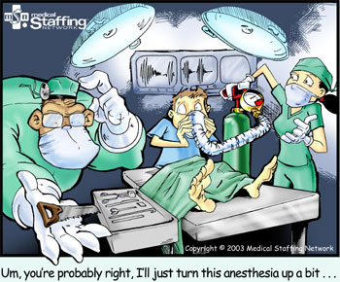
Your role – Understanding the Design
It will be important for you to review and understand:
  the stages of training
  the associated EPAs and milestones
  the required training experiences (RTE)
  the associated assessment strategy your program is using

Slide 39
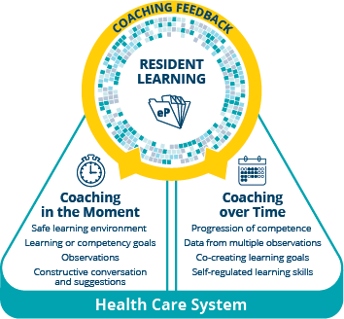
Your role – Feedback and Coaching
Feedback and coaching are key elements of the CBD design:
  It is important to stay on top of your learning, be proactive in taking advantage of learning opportunities
  You are encouraged to ask for feedback, make it a regular part of your interactions with faculty, ie: have a conversation at the beginning of the interaction/clinic around what EPAs you are working on
  Your assessments are FOR learning, not OF learning
  Approach Feedback and Coaching with a Growth Mindset

Slide 40
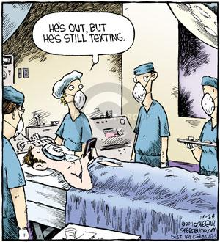
Your role
Remember, you won’t improve without feedback and coaching
Don’t be surprised or disappointed to be told you need to work on certain things
Take time to reflect on the feedback/coaching you receive

Slide 41
Your role – Workplace-Based Assessments
Documentation of these authentic interactions with faculty is key to ensuring your program has relevant data about your progress:
    Keep track of the EPAs and their relevant assessments
    Are you on track to have the required numbers?
    Are you on track to meet the contextual variable requirements?
  Gently remind faculty to document your interaction
  Use the functions on your e-platform to help with this (ie: send a reminder email)

Slide 42
Your role – Big Picture
Make
Make sure to ask questions when something is not clear (or not working!)
Ensure
Ensure you are receiving useful feedback that is specific and actionable – your program will also help to monitor this
Seek
Seek opportunities for mentorship by peers, and to mentor peers both around performance and learning about training opportunities
Provide
Provide program and faculty with feedback – during the feedback session if appropriate or through your program’s online teacher evaluation system. They too need to know how they are doing!
Need
Need to enjoy this time!

Slide 43
Faculty role
To ensure that the overall program design can provide all that is necessary to produce a competent specialist in the discipline
To ensure that all the components of CBD are mapped to appropriate places in the curriculum
To ensure appropriate exposure to experiences that provide opportunities to meet the EPAs and become entrusted
To develop faculty, educating them about CBD and their role including: EPAs and milestones, providing feedback and coaching, using the electronic platform, supporting residents for success
To foster a Growth Mindset in the institution, themselves and the trainees

Slide 44
Faculty role
To orient residents as they begin their CBD journey:
  Overall curriculum
  EPAs and milestones, including number required for entrustment
  Competencies
  Required Training Experiences (RTE’s)
  Local assessment strategy including all modalities of assessment
  How the competence committee report will be shared with residents
  How mentorship will work – PD or Academic Advisor

Slide 45
Faculty role
Ensure
Ensure Resident wellness and resilience
Fireside chats with PD
Balint groups
Ice-cream rounds
Engagement committee activities
Wellness group activities
Dissemination of wellness resources
Mentorship diads with upper year residents
Ensure
Ensure residents are aware of avenues to provide feedback to the program – Continuous Quality Improvement
Connect
Connect residents with peer mentors

Slide 46

Preparing for and overcoming common challenges – Lessons learned
Here are some challenges/frustrations you may encounter:
  Feeling like you’re chasing EPAs
  Faculty saying "no" or not responding to observation requests you send through the electronic platform
  Some faculty who may not have bought into CBD yet
  Faculty don’t seem to understand the entrustment scale
  Thinking you need to wait until you can get a 4 or a 5 on EPA observations, otherwise what is the point?
  Not always getting timely, actionable feedback
  Using cumbersome electronic platforms
  Feeling like this is a lot of extra work
  Not understanding how EPAs link to learning
This photo by Unknown Author is licensed under medium.com (public domain)
Notes:
This slide may lend itself to either small breakout groups, or a large group session. It would be best facilitated by those with some experience. Have the groups work thought some of the challenges and find solutions. It is really helpful if residents understand that these issues may come up and how to mitigate them.
Feeling like you’re chasing EPAs – stay on top of what is mapped where, if it feels like too many, provide this FB to your PD and CC chair
Faculty saying "no" or not responding to observation requests you send through the electronic platform - Your program will work with faculty to engage them, but it will take time.
Some faculty who may not have bought into CBD yet – same as above
Thinking you need to wait until you can get a 4 or a 5 on EPA observations Remember, there will be EPAs in which you are not entrusted, this is normal, they are developmental, embrace the feedback and coaching with a growth mindset, you will get there.
Not always getting timely, actionable feedback - your programs fac dev will work on this
Using cumbersome electronic platforms
Feeling like this is a lot of extra work
Don’t forget to find out more from your PD or PA about:
the Competence Committee process
how your EPAs map to your rotations
completing EPAs during off-service rotation

Slide 47
Solutions
We hear you
Faculty Development is happening
  Feedback and coaching
  Entrustability
  Implementation of the WBAs
  Working with faculty to meet learners ½ way
Growth mindset – don’t need to be entrusted every time, coaching FOR learning
Open forum, town halls, continuous boluses of information

Slide 48

Solutions
Don’t forget to find out more from your PD or PA about:
  the Competence Committee process
  how your EPAs map to your rotations
  completing EPAs during off-service rotation
This photo by Unknown Author is licensed under bath-business.net (public domain)

Slide 49
Solutions
Poster list of EPAs in clinic space
QR codes to take residents right to the e-platform
Resident “paragraph” to faculty when requesting a WBA
Buttons “ask me to do an EPA”
Competitions within clinical areas
Report cards – how is an area doing
EPA champions – who is making it work and how are they doing it? (residents and faculty)
Bootcamp for PDs and PAs and CC chairs
Frequent boluses of information
CQI Process

Slide 50

How will you know how you are doing?
This photo by Unknown Author is licensed under fotomelia.com (public domain)

Slide 51

Mentorship Meeting
This photo by Unknown Author is licensed under Pixabay (public domain)

Slide 52

Competence Committee
This photo by Unknown Author is licensed under Clipart-library.com (public domain)

Slide 53
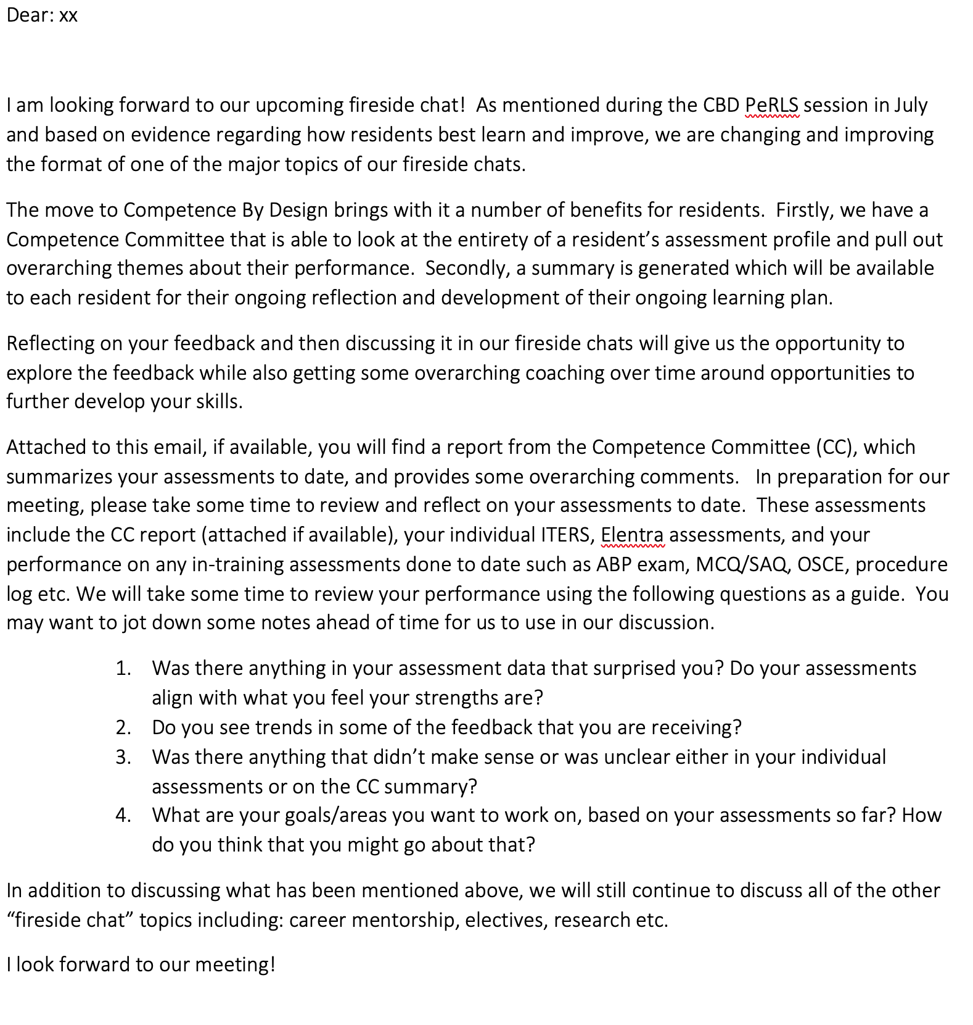

Slide 54
Summary – what we said we would do
By the end of this session you will be able to:
Be familiar with an “off the shelf” resource that can be implemented to orient new residents to Competence By Design (CBD) for your CBD launch in July.
Have discussed planning for local program resident development for the 2022/23 academic year.
Have shared ideas and “tips and tricks” with colleagues across the country about preparing residents for CBD.

Slide 55
Thank You
royalcollege.ca • collegeroyal.ca

