Slide 1
This presentation was developed for your faculty development needs, non-commercial creative commons use, and dissemination.
Please attribute source material to the Royal College of Physicians and Surgeons of Canada
Questions? Email cbd@royalcollege.ca

Slide 2
Milestones and Entrustable Professional Activities (EPAs)
Updated October 2024

Slide 3
Objectives
Describe the CanMEDS Framework and how it informs training
Explain milestones, EPAs, and the differences between them
Describe how programs use milestones and EPAs to develop their curriculum and design their program of assessment
Milestones and EPAs

Slide 4
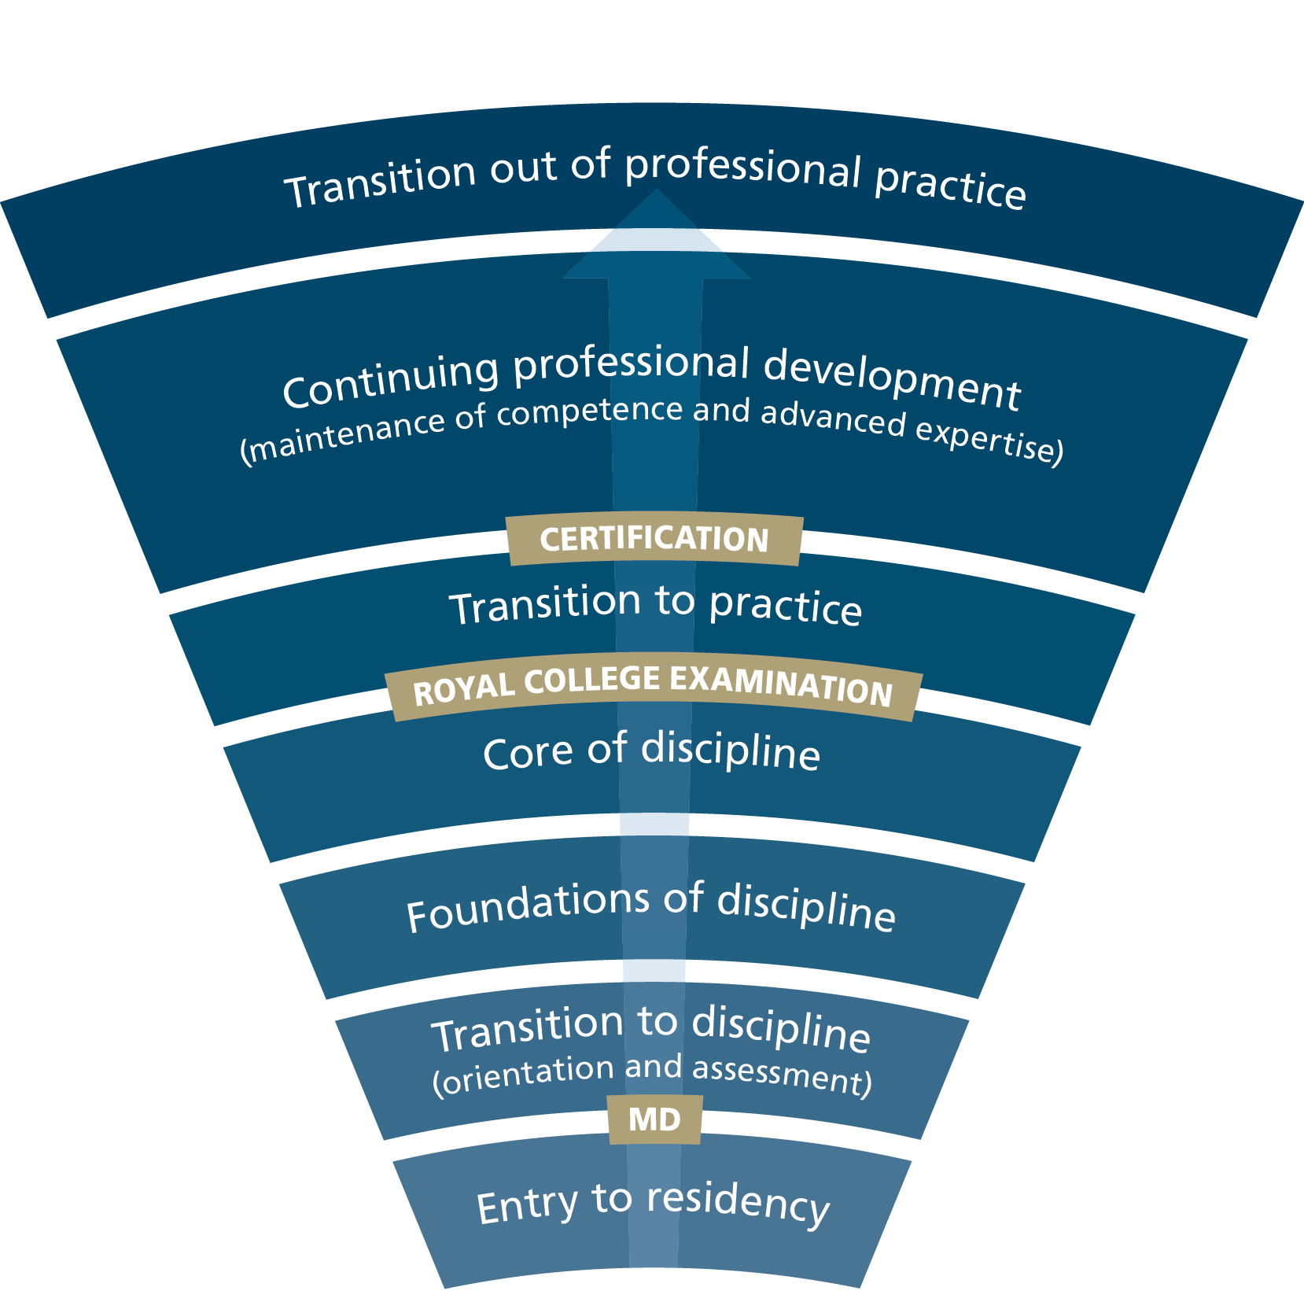
Competence Continuum
Milestones and EPAs
Notes:
CBD is built upon the idea that the learning continuum – from residency to retirement – can be broken down into a series of stages of progression. At each stage, CBD asks what is the desired outcome.
So, for learners in “Transition to practice” the questions is “What are the skills and abilities that learners need to successfully practice independently?”

Slide 5
The CanMEDS framework
CanMEDS is a physician competency framework that identifies and describes the abilities physicians require to effectively meet the health care needs of the people they serve
It is the foundation for all Royal College educational standards
First developed in the 1990s and formally approved by the Royal College in 1996
  Last revised in 2015 (CanMEDS 2015 Framework)
  Evolved framework expected in 2026
Milestones and EPAs

Slide 6
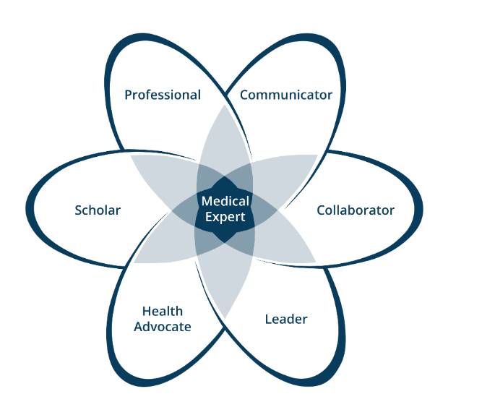
CanMEDS diagram
Seven roles:
  Medical Expert
  Communicator
  Collaborator
  Leader
  Health Advocate
  Scholar
  Professional
Milestones and EPAs
Notes:
CanMEDS articulates a comprehensive definition of the abilities needed for all domains of medical practice. These abilities are grouped thematically under seven roles: Medical Expert, Communicator, Collaborator, Leader, Health Advocate, Scholar and Professional. A competent physician seamlessly integrates the competencies of all seven CanMEDS Roles.

Slide 7
How CanMEDS informs training
Using the CanMEDS Framework as a guide, disciplines:
  Separate their specialty into stages of training
  Develop specialty-specific milestones and Entrustable Professional Activities (EPAs) for each stage of training
Milestones and EPAs

Slide 8

What is a milestone?
A milestone is defined, observable marker of an individual's ability along a developmental continuum
  Used for planning and teaching
  Based on CanMEDS roles
Example: Medical Expert (ME) 2.2 Perform a physical exam that informs the diagnosis.
This Photo by Unknown Author is licensed under CC BY-NC-ND
Milestones and EPAs
Notes:
Within each stage, CBD looks at the abilities and activities that are needed to meet these desired outcomes. These abilities and activities are assigned as markers of competence for the stage.
Abilities of the individual learner are called milestones.

Slide 9
What is an EPA?
An Entrustable Professional Activity (EPA) is an essential task of a discipline, as defined by that discipline’s specialty committee
  Used for assessment
  Linked to a specific stage of the competence continuum
  May be delegated to a resident once sufficient competence has been demonstrated
Example: Transition to Discipline (TTD) EPA #3A. Assessing and providing initial management for patients with life-threatening problems, seeking assistance when appropriate.
Milestones and EPAs
Notes:
The activities or tasks that need to be accomplished are known as Entrustable Professional Activities or EPAs.

Slide 10
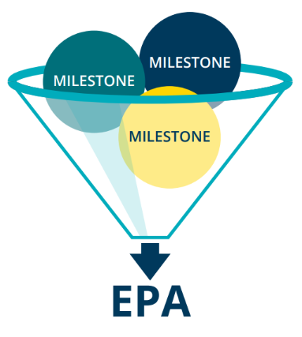
EPAs – for teaching, coaching and assessment
EPAs are a clinically relevant way of doing an assessment that encompasses a large number of milestones, or abilities
Based on observations of the resident’s ability to perform the EPA, you can assess if they can be entrusted to perform this EPA in the future
Milestones and EPAs

Slide 11
What’s the difference?
Transition to Discipline (TTD) EPA #2 Documenting orders for pediatric patients.
CanMEDS milestones
COM 5.1 Document patient care orders
ME 2.4 Adjust medication dosing for patient age, size and/or other relevant factors
COM 5.1 Organize information in appropriate sections
ME 2.1 Recognize situations requiring direct communication of orders to the appropriate team member
P 1.1 Complete assigned responsibilities in a timely fashion
Milestones and EPAs
Competence by Design: Overview
Notes:
The key difference between EPAs and milestones is that EPAs are the tasks or activities of the profession that must be accomplished, whereas milestones are the abilities of the individual.
As you can see from this example, typically, one EPA is made up of several teachable milestones.
COM = Communicator
ME = Medical Expert
P = Professional

Slide 12
Milestones and EPAs within each stage of training
Provide clear learning and teaching paths
  As residents progress through the stages of the Competence Continuum, the EPAs become progressively more complex
Remove need to teach or evaluate everything at once
  Focused on discrete clinical tasks
Allow for regular, meaningful feedback, tracking, and coaching
Milestones and EPAs
Notes:
Taken together, milestones and EPAs will layout a clear learning plan for residents and clear teaching and assessment goals for educators.
Residents will progress to the next stage of training when they successfully demonstrate they have achieved the various EPAs within their current stage.
Supervisors will use the EPAs to perform regular, discrete assessments throughout each stage.
The targeted-nature of the EPAs will foster the delivery of authentic and concrete feedback, and the regularity of the assessment will also allow educators to support struggling residents earlier and support all trainees by giving them the feedback they need to improve their performance

Slide 13
Teaching and assessing
Programs are expected to map EPAs (as well as the Competencies and Required Training Experiences) to their rotations/curriculum, and identify how each of these training requirements will be assessed
Educators use milestones to design educational activities and teach specific abilities
Once the skills/attitudes required to meet the milestones have been taught, educators can assess achievement of the EPA
If the EPA is successfully performed, then all the skills which make up the various milestones within the EPA have been learned and competence has been demonstrated
Milestones and EPAs

Slide 14
Questions?

Slide 15
Thank You
royalcollege.ca • collegeroyal.ca

