Slide 1
Competence Committees
Adelle Atkinson

Slide 2
Objectives
By the end of this session, we will have:
Discussed: Why Competence Committees?
Reviewed the role of Competence Committees
Reviewed how to design a Competence Committee
Discussed how Competence Committees make decisions

Slide 3
Why Competence Committees?
Assessment Systems Are Criticized:
  Too few observations
  Too few data points
  Often not defensible
  Poor reliability
  Too subjective
  Not authentic
  Sometimes impractical (too much; n/a)
Notes:
Our current assessment systems in medicine are criticized for their lack of numerous observations, not enough direct observation, lack of actionable feedback and of course failure to fail.

Slide 4
Method reliability as a function of testing time
Practice Video Assess- ment⁷
Testing Time in Hours
Case- Based Short Essay²
In- cognito SPs⁸
Oral Exam³
Long Case⁴
Mini CEX⁶
MCQ¹
PMP¹
OSCE⁵
1 0.62
0.68
0.36
0.50
0.60
0.54
0.73
0.62
0.61
0.76
2 0.77
0.81
0.89
0.53
0.67
0.75
0.70
0.84
0.92
0.77
0.87
0.93
4 0.87
0.69
0.80
0.86
0.82
0.86
8
0.93 0.94 0.82
¹Norcini et al., 1985
²Stalenhoef-Halling et al., 1990 ³Swanson, 1987
0.89 0.92
0.90
0.96
0.93
⁴Wass et al., 2001
⁵Van der Vleuten, 1988
⁶Norcini et al., 1999
⁷Ram et al., 1999
⁸Gorter, 2002
From CPM Van der Vleuten; ACGME 2016
Notes:
This data shows you, that if you look at the testing time in hours, the greater the testing time, the greater the reliability of many forms of assessment, many of which we are currently using.

Slide 5
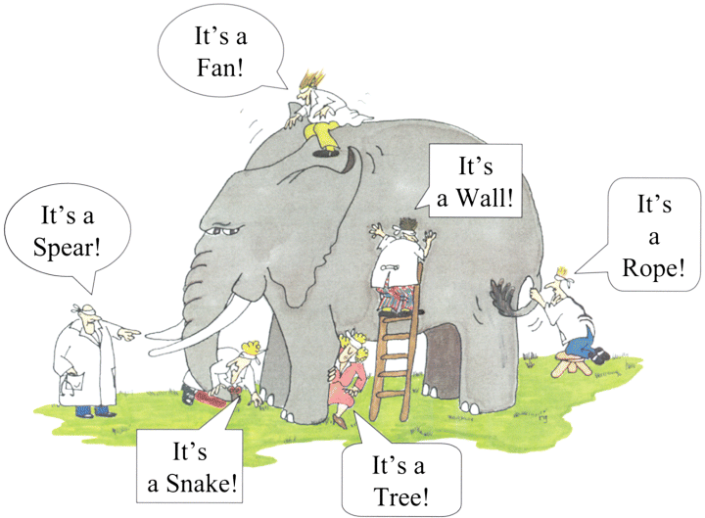
Notes:
This is an elephant. But the scientists are blindfolded and only given one data point to make an assessment of what this is. With more data points, they may get closer to the truth.

Slide 6
What is the role of a Competence Committee?
Notes:
So what is the role of a competence committee

Slide 7
What is the role of a Competence Committee?
to review and make decisions on a learner’s achievement of EPAs and their progression through the stages of training toward the national standards as set by the discipline.
provides guidance for training activities to help a resident progress within his/her current stage.
Committee decisions and recommendations are made using highly integrative data from multiple EPA and milestone observations as well as feedback from clinical practice.
Notes:
Model by which residents are evaluated is based on the premise of “Assessment for learning” as opposed to “Assessment of learning”

Slide 8
What is the role of a Competence Committee?
Supervisors observe and record low stakes observation based on how the resident performed
They don’t have to make the final assessment
The CC takes all the low stakes assessments and other assessment data and through the CC structure make promotion decisions
Notes:
The Competence Committee takes the role of reviewing all of the data on a given resident (assessments and other assessment data such as OSCE scores, MCQ scores etc.) and in an evidence informed way, makes decisions as to a resident’s progress with their EPAs and other program requirements, and bench marks them against their peers. This committee will also make the decision as to whether a resident is ready to move to the next stage.

Slide 9
What is the role of a Competence Committee?
Empowered to make decisions on:
  Residents progressing from one stage to the next
  Reviewing and monitoring individual learning programs
  Readiness for RCPSC exams
  Readiness for unsupervised practice
Big decisions need to be ratified by the RPC
Guided by a National Competency Framework
Notes:
The CC reports to the RPC, so each CC will need to think about how this reporting will work practically.

Slide 10
How do you set up a Competence Committee?
Competence Committee Resources - RCPSC website
Guidelines put together by the RC and PG Dean’s Assessment Advisory Working Group
These are guidelines only, local context is important in setting up your CC
TOR that can be used/modified for your Committee
Notes:
Check out the resources on the RC website. There are documents put together by the RC and the PG Dean’s Assessment Advisory Working Group, ad your local CBD leads can also help with this as well as many other aspects of the assessment piece.

Slide 11

How do you set up a Competence Committee – nuts and bolts
Subcommittee of the RPC, or separate committee with members outside the RPC
Membership:
  Chair
  PD
  1 faculty per 8 to 10 residents
  Primary reviewer
  Meet monthly/quarterly (depends on program size) – each resident should be discussed a minimum of twice/year
  What about an academic advisor?
Notes:
When asking faculty to participate, ensure they know the time commitment and what their role is. Diversity on the committee is important, both of job types, of experience, seniority and of thought. Academic advisors are being implemented in some programs. This is not a requirement of the college.

Slide 12
How do you set up a Competence Committee – the nuts and bolts
Set an agenda for every meeting, all members should know which of their residents (primary reviewer) are being discussed, so they can prepare
The agenda will state which stage they are currently at
The primary reviewer will review the portfolio, benchmark against other learners, and provide a recommendation on learner status
The committee will discuss the themes arising from the review and the learner status. A vote may be taken
The committee will come up with a developmental plan for each resident
Results should be shared with the learner with steps moving forward
Notes:
Some really useful feedback we have had around setting up Competence Committees is that there needs to be guidance on how the meeting is going to progress, and suggested ways of presenting also saves time and ensures an organized way of presenting..

Slide 13
Primary Reviewer
Opening statement:
  “I reviewed Jane Doe who is currently in Foundations. I am going to recommend her for a modified learning plan”
  Proceed to present relevant and supportive data
  Like a “clinic visit”, what is relevant to this decision today.
Notes:
An example of how one might present a resident they are responsible for reviewing.

Slide 14
How does the Competence Committee report to the RTC?
The Chair would be asked to report to the RPC
The development of learning plans for each resident must be decided locally
Learning plans should be developed for all residents, including those who are doing extremely well
With time, these plans will be re-usable with residents in similar stages developmentally

Slide 15
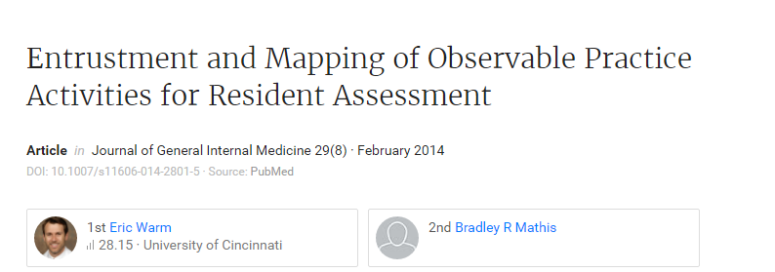
Eric Warm: Cincinnati
Notes:
People have been doing this for a long time and there is data. Eric Warm has published a great deal on entrustment and observations.

Slide 16
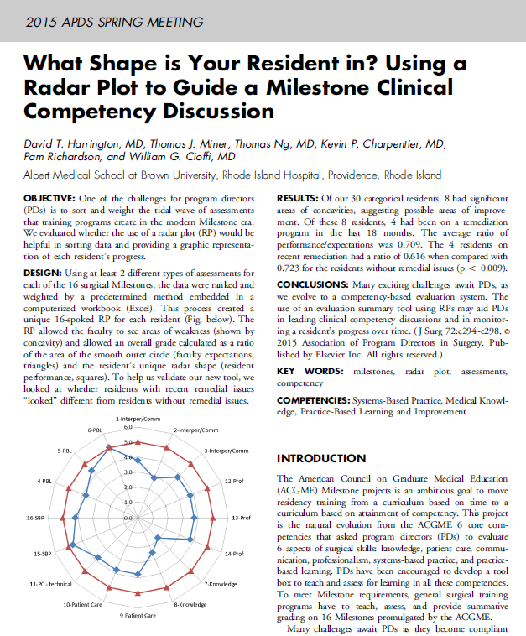
Notes:
Learning analytics, if you can map a trajectory you can identify residents who will struggle within three months. This might be a way that your learner’s results are reported to you. This spider plot shows where a resident is in relation to their peers. Very useful information for the CC.

Slide 17
Basic Committee Principles
Evidence-based versus verdict-based “jury”
  Start and review all evidence before a decision
    Do not start with a conclusion/decision
  Confirmation bias
Be careful not to emphasize consensus over dissent
  Minority opinions, even if “wrong”, still helpful
  Be sure all voices are “heard” and watch carefully for negative effects of hierarchy
Notes:
Hearing many opinions leads to rich discussion and is helpful for the resident in the long run.

Slide 18
Theories Supporting Group Process
Social decision scheme theory (Stasser)
  Social decision schemes are the methods
  used by a group to combine individual responses into a single group decision
Conversation theory (Pask; Pangaro)
  Creating understanding and meaning through dialogue
Paradox of Group Life (Berg)
  Paradox an inherent part of group life
Notes:
There are many theories supporting group process.

Slide 19
Committee Benefits – Dr. Eric Holmboe
Develop group goals and shared mental models
“Real-time” faculty development
Key for dealing with difficult trainees
Share and calibrate strengths and weaknesses of multiple faculty assessments (“observations”)
A place to synthesize the intrinsic roles
Notes:
What is in it for me? Dr.Holmboe emphasizes the value of CC and also the value to the members of the committee not just the residents.

Slide 20
“Wisdom of the Crowd”
Hemmer (2001) – Group conversations more likely to uncover deficiencies in professionalism among students
Schwind, Acad. Med. (2004) –
  18% of resident deficiencies requiring active remediation became apparent only via group discussion.
    Average discussion 5 minutes/resident (range 1 – 30 minutes)
Notes:
There is evidence, that group discussion can “unmask” deficiencies that might not have otherwise been identified.

Slide 21
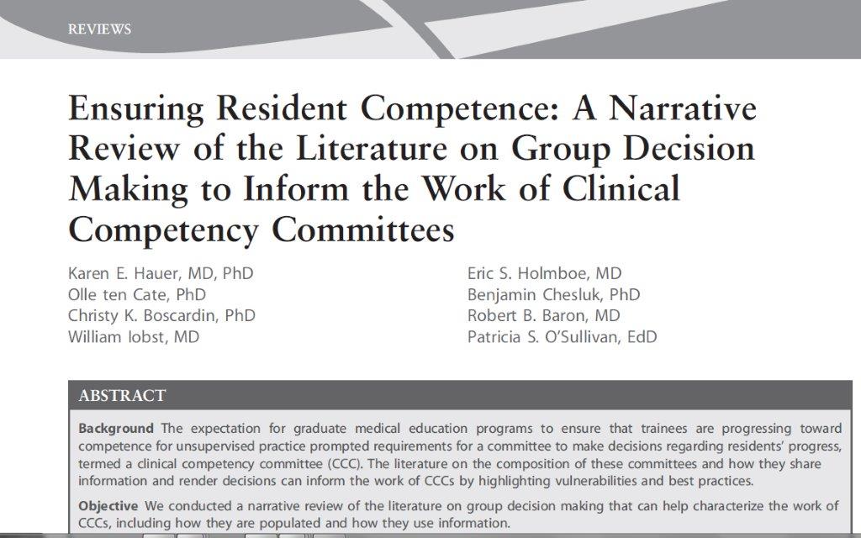
Keylime Podcast - Role of Competence Committees
Notes:
Have a listen to this podcast that reviews a paper on group decision making and the work of CC

Slide 22
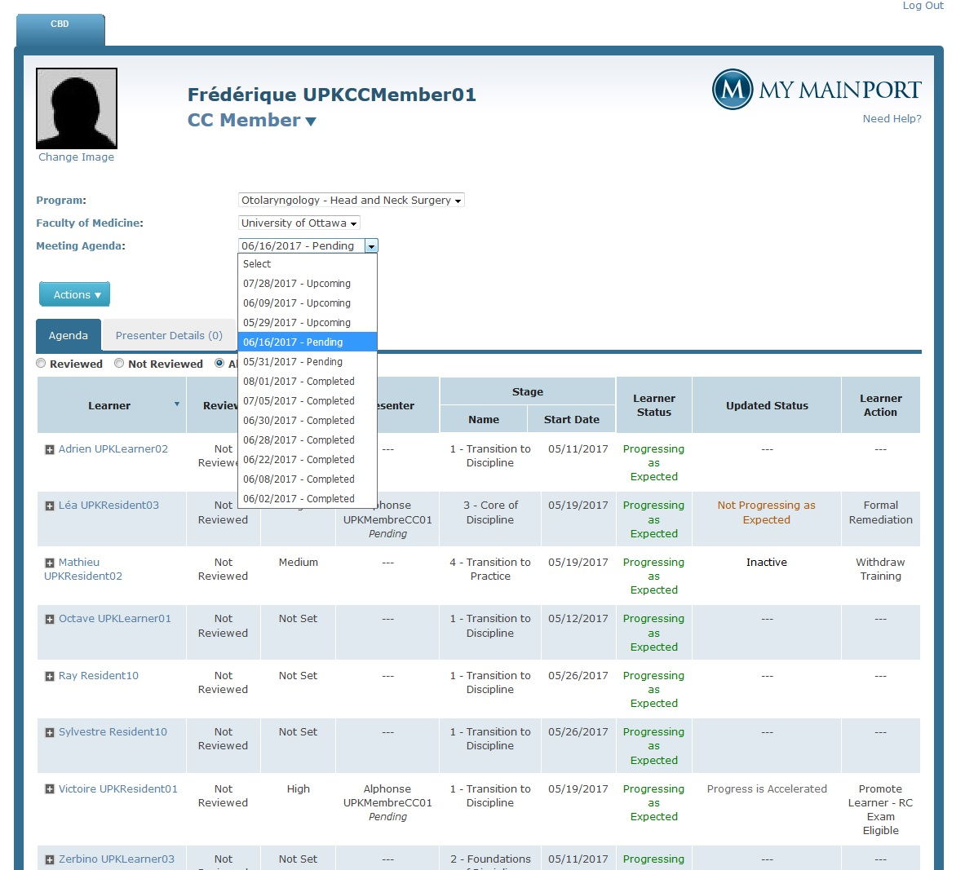
ePortfolio: Competence Committee Agenda
Notes:
Depending on the electronic platform that you are using, there will be access for the CC such that they can see the resident data they need to prepare. The data will likely be reported in different ways.

Slide 23
Resources
Hauer, KE et. al. Reviewing residents' competence: a qualitative study of the role of clinical competency committees in performance assessment. Academic Medicine. 2015 Aug;90(8):1084-92
Keylime Podcast - Role of Competence Committees
Competence Committee Resources - RCPSC

Slide 24
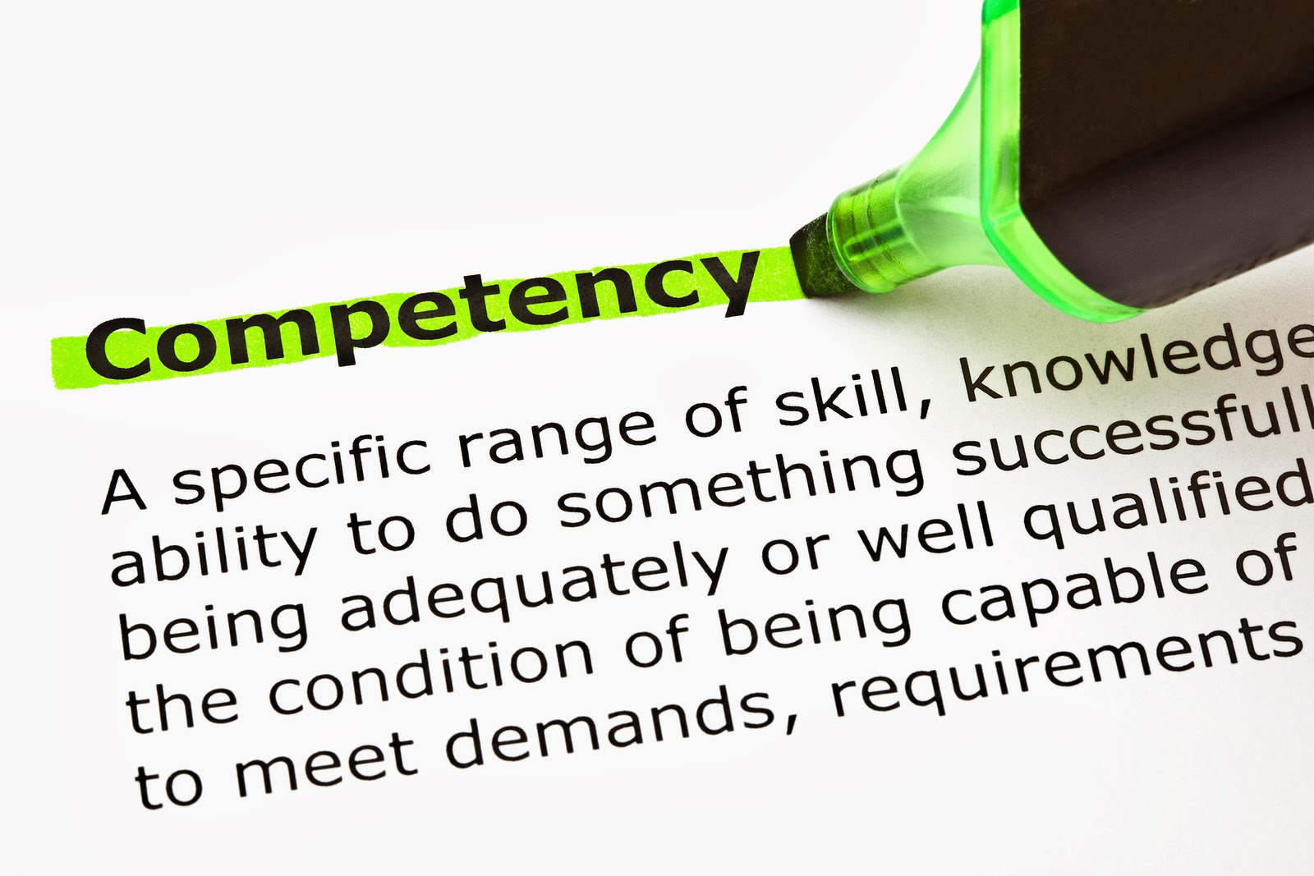
Thank you!

