Slide 1
CBD COACHING MODEL
Denyse Richardson, MD, MEd, FRCPC
Notes:
This presentation assumes an understanding of CBD and workplace-based assessment (WBA), including the need for formative assessment.
If your ‘end-users’ don’t have this background, then you should first introduce them to the following slide deck - http://www.kaltura.com/index.php/extwidget/preview/partner_id/1688662/uiconf_id/22517242/entry_id/1_n8prqyfy/embed/auto?
Detailed notes are included to assist presenters and viewers who may be unfamiliar with some of these concepts. If you are presenting this deck, you are encouraged to edit the presentation to reflect the most relevant slides for your audience and purpose.
You are encouraged to share and/or modify these slides as needed, but please source the Royal College.
All text and logos contained herein are the property of the Royal College of Physicians and Surgeons of Canada.
Questions? Email cbd@royalcollege.ca

Slide 2
Contributors
Special thanks to the following individuals who contributed to the development of this module:
Denyse Richardson, MD, MEd, FRCPC
Carol Aschenbrener, MD; Chief Medical Education Officer, AAMC (retired); Executive Coach (current)
Farhan Bhanji, MD, MHPE, FRCPC
Marissa Bonyun, MD, MEd
Rose Hatala, MD, MSc, FRCPC
Shelley Ross, PhD
Joan Sargeant, MEd, PhD
Shirley Schipper, MD, CCFP, FCFP
Chris Watling MD, MEd, PhD, FRCP(C)
Notes:
Special thanks to the following individuals who contributed to the development of this module:
Denyse Richardson, MD, MEd, FRCPC
Carol Aschenbrener, MD; Former Chief Medical Education Officer, AAMC (retired); currently Executive Coach
Farhan Bhanji, MD, MHPE, FRCPC
Marissa Bonyun, MD, MEd
Rose Hatala, MD, MSc, FRCPC
Shelley Ross, PhD
Joan Sargeant, MEd, PhD
Shirley Schipper, MD, CCFP, FCFP
Chris Watling MD, MMEd, PhD, FRCP(C)
This group included clinicians, a resident, education researchers and an executive coach.

Slide 3
Objectives
Describe the components of the CBD Coaching Model
Distinguish ‘Coaching in the Moment ‘and ‘Coaching over Time’
Explain how coaching feedback is integral to learning
Notes:
These slides will review the following -
1) the CBD coaching model,
2) what defines Coaching in the Moment and Coaching over Time,
3) the undeniable need for feedback and coaching in CBD.

Slide 4
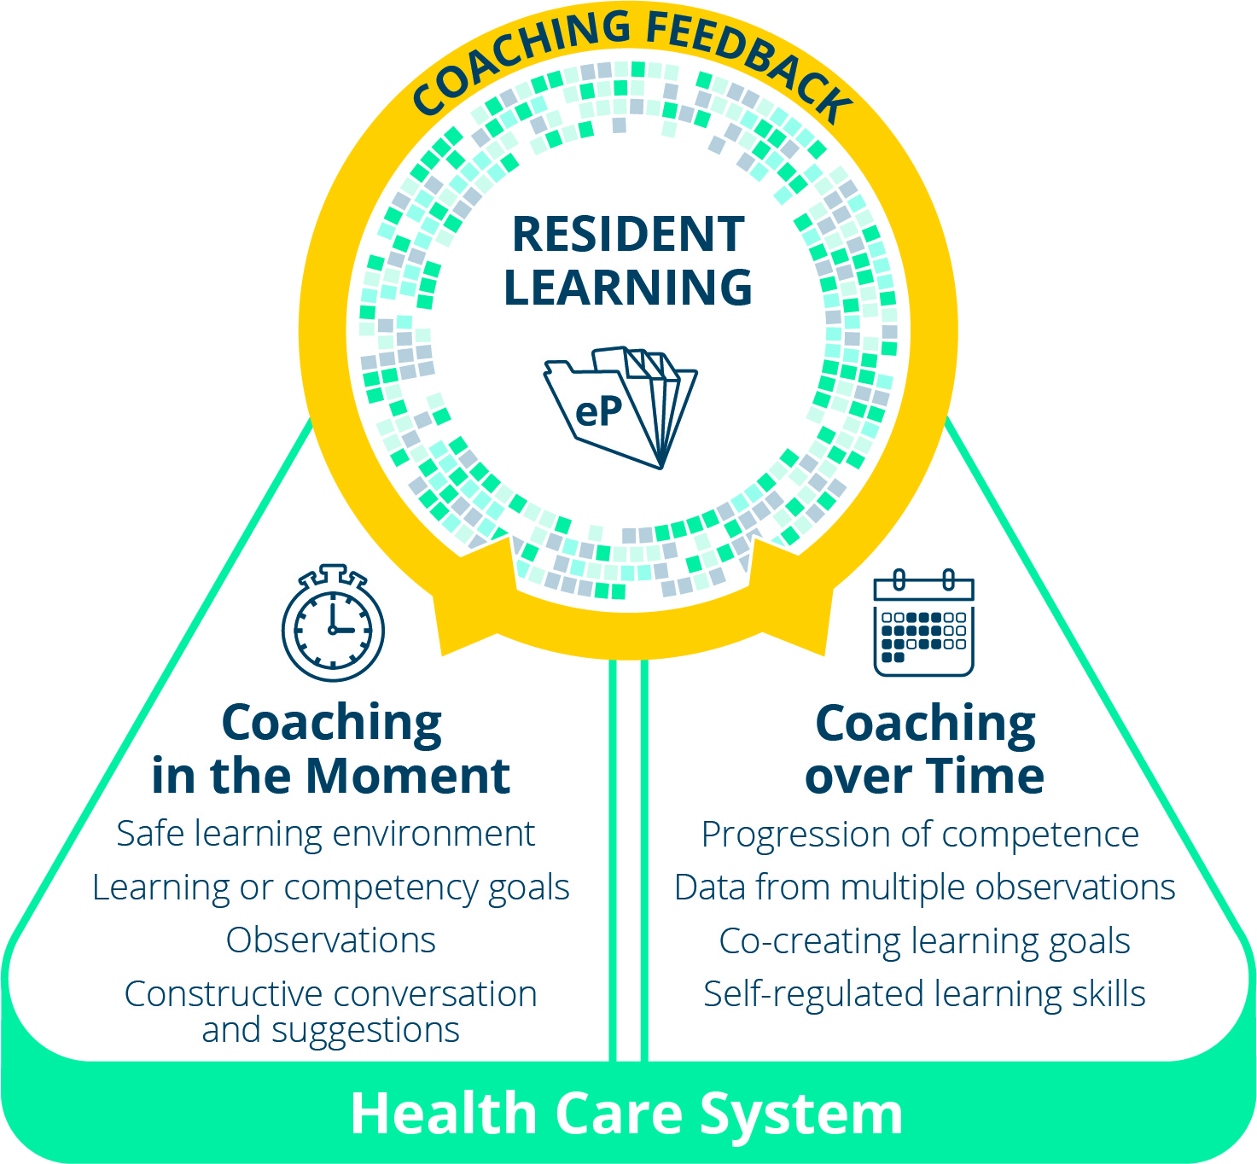
CBD Coaching Model
Facilitating learning and development of a residents’ competence
Notes:
This is a graphic representation of the Coaching Model that has been developed to support resident learning and progressive competency development in CBD (Competence by Design)
Resident learning is the focal point at the top of the graphic and reflects the importance of a learner-centred, developmental approach to competency acquisition.
Coaching feedback is the prominent method to facilitate the learning and development.
Resident learning is captured by documentation that is kept in the e-Portfolio and the blue pixelated ring represents the increasingly filled in depiction of the resident’s competence as development of expertise occurs.
There is also a deliberate direct connection between the resident and the coach for both Coaching in the Moment and Coaching over Time, illustrating the importance of the collaboration that must occur between those involved in these roles for the benefit of resident learning and progression.
The foundational layer, the Health Care System, is a recognition that resident learning (and coaching) is occurring within the workplace of the complex Health Care system and that real patient care is part of the learning context.
Before describing the coaching components of the model in more detail, the next few slides will address the context surrounding it.

Slide 5
Competence by Design
  Improve patient care by assuring our residency programs facilitate the developmental acquisition of competencies
  Competency Focused Instruction
  Workplace-Based Assessment (WBA)
Notes:
Competence by Design (CBD) is the RC’s CBME initiative. An important goal of CBD is to assure our residency programs facilitate residents’ progress along a continuum of competency acquisition, so that ultimately the best care is delivered to our patients.
A Coaching model is critical to 2 key components of the CBD Model:
competency focused instruction and
workplace-based assessment.

Slide 6
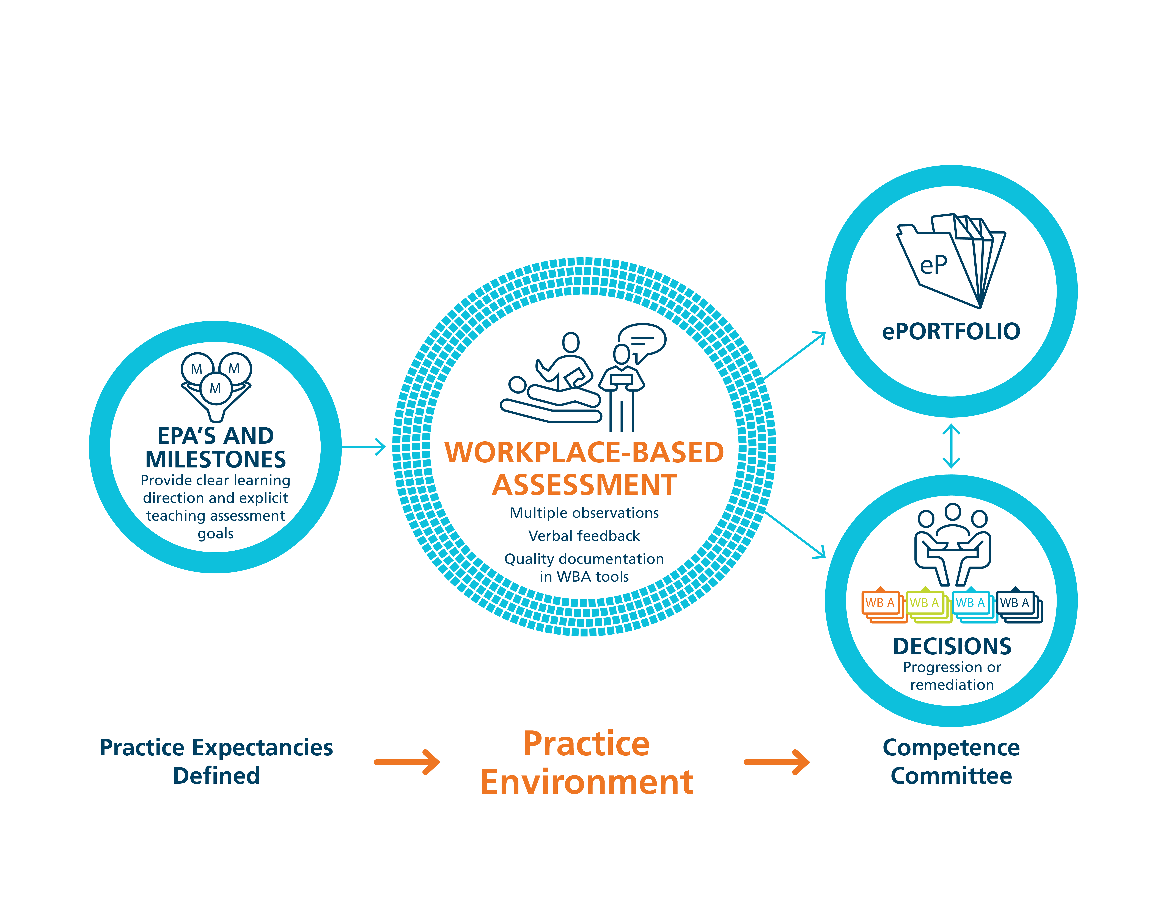
Workplace-Based Assessment in CBD
Notes:
FACILITATOR TIP: One of the most notable changes for clinical teachers as they transition to Competence by Design (CBD) is the need for more frequent observation, allowing coaching feedback and documentation. In some cases, your colleagues are already doing this, which is a bonus for your program. In those cases where observation and feedback is less common, though, you may find it helpful to introduce these concepts using a slide deck like this one and then reinforce the messages and behaviours using resources like the 2 page Coaching Model handout, Coaching Snippets and even the WBA resources. Help them see the value in the aforementioned philosophical shift and, more specifically, the distinction between Assessment OF versus FOR Learning. How deeply you cover this content will depend on your group readiness.
Coaching as a method of teaching and learning for competency progression.
From the coaching standpoint, the purpose of workplace-based assessment , which occurs in the practice environment, must be understood and accepted as formative, in other words, for the purpose of informing learning. The goal of WBA is to provide specific feedback to enable resident development.
The documentation of the feedback and coaching suggestions (kept in the resident’s ePortfolio) will however, be part of what the competence committee uses to make decisions about EPA achievement.
Coaching is about learning and improving performance, not assessment and judgement!

Slide 7

Coaching
“… can help learners reflect on where their performance stands and how to improve.”
- Deiorio, N., 2016
Notes:
A coach is a person who “… can help learners reflect on where their performance stands and how to improve” (Deiorio, 2016). Coaching is beneficial for anyone who is pursuing optimal performance.
Coaches can help an individual to do a task better, develop a skill they don't yet possess or achieve a specific goal.
Coaching helps a learner understand what adjustments and modifications will allow them to progress to the next level of capability/proficiency.
Coaching is giving actionable concrete suggestions for improvement.
In CBD, the role of clinical teacher is evolving from supervisor to observer and coach. When clinical teachers directly or indirectly observe the work residents do, these observations provide learning opportunities.
Image source: https://pixabay.com/en/softball-player-coach-game-1511264/

Slide 8

Coaching
A coach’s priority is to promote improvement
Notes:
Judgment is NOT the purpose of the observation (Assessment). Of course, a coach will make decisions about the quality of the task performed but a coach’s priority is to promote improvement.
A coach always has the best interests and goal of performance improvement of the resident as their primary concerns. Beneficence of the learner!
Although coaching does involve observing the task, the purpose of observation is for the coach and resident to identify learning opportunities.
Coaching is a form of teaching or instruction. It is focused on future performance or practice and is developmental.
Image source: https://pixabay.com/en/white-male-3d-man-isolated-3d-1871366/

Slide 9
Growth Mindset
Growth Mindset: Aligns with coaching as a teaching and learning method to promote development.
Fixed Mindset | Growth Mindset
Believes that level of achievement is predetermined, and that effort dedicated toward learning will not promote greater achievement. | Believes there is potential for an individual’s growth and improvement .
Desires to prove and avoid looking unintelligent. | Desires to learn, and looks for opportunities to challenge current status.
Asks: Will I succeed or fail? Look smart or not? | Asks: Will I grow? Will I overcome challenges?
Questions the effort of bothering. | Believes that growth and learning require effort.
Ignores constructive criticism. | Learns from feedback and uses it to improve.
Click to review full table (English only)
Dweck, 2006
Notes:
Carol Dweck is Psychology professor, at Stanford University, in California, and she has been doing research on achievement and success of students for the last several decades. She coined the terms “Growth Mindset” and “Fixed Mindset” to describe peoples beliefs about and therefore their approach to learning.
The Growth Mindset, is one in which it is believed that there is potential for an individual’s growth and improvement and this very much aligns with coaching as a teaching and learning method to promote development.
Whereas someone who ascribes to the Fixed mindset (example features of which are in the yellow column) believes the level of achievement is predetermined, and effort dedicated toward learning will not promote greater achievement.
According to Dweck, someone with a Growth mindset has:
a high DESIRE to learn, looks for opportunities to challenge their current status & grow as a result of taking on challenges,
learns from feedback and wants to know how to improve, while recognising that the improvement will require practice and effort.
In contrast, someone with a Fixed Mindset perspective:
approaches situations with a judgement lens, wondering “how will I look – smart or not?” Individuals who are of a Fixed Mindset don’t value challenging situations as learning opportunities
because effort is pointless as is responding to feedback
If we consider this in the context of clinical teaching, from the residents’ perspective – someone who is aligned with a Fixed Mindset would view observation done by a coach as an assessment at that point in time for what they know, and that judgements and decisions about my future will be made based on this point in time status. This could be called an “assessment OF the learning” that has taken place.
Someone holding a Growth mindset, would see an opportunity to have an expert coach observe their work at any point in time as an opportunity to get expert input and feedback on what they could improve. This could be called an “assessment FOR learning”
Dweck, C. S. (2006). Mindset: The new psychology of success. New York: Random House.

Slide 10
Paradigm Shift of Thinking
Assessment
OF Learning
“Summative assessment”
Assessment FOR Learning (Observations)
“Formative assessment”
Embedded in the learning process (frequent and ongoing)
Goal: judge/evaluate learning at that particular instant in time
Happens at the end of the learning process
Low stakes, safe environment
High stakes
Goal: monitor learning/progress and provide immediate feedback that can be used to improve teaching/learning (feedback loop)
Notes:
FACILITATOR TIP: This slide is illustrating a change in how we, residents and teachers, need to view and value observation and assessment. A shift in thinking to Assessment (Observation) FOR Learning is a big part of the change required for CBME to work. This is a paradigm shift that will take time.
To be truly successful, the CBD coaching model requires an important philosophical shift in thinking about assessment of residents and, particularly, the purpose of such assessment. In our current system, many of our commonly used assessment methods do not get at what a resident does on a typical clinical day. There needs to be more observation of residents doing their daily work, rather than performing in a “testing” environment/situation. Hence, the emphasis on Assessment FOR the purpose of Learning needs to be far greater than what currently exists. In other words, assessments (or observations) identify opportunities for learning.
Within a mindset of Assessment OF Learning (summative assessment), the predominant purpose for assessment is that of a judgement or evaluation of what a resident knows or can do at that particular instant in time (or sometimes even a judgement of what the resident doesn’t know or can’t do). This can create unease for the resident and often puts them in a position of performing – doing what they believe is on “a checklist” as opposed to doing what they would normally do, as they felt appropriate, in the real clinical environment.
With a shift in mindset, to the framing of Assessment FOR Learning (formative assessment), the purpose of assessment is to be part of a process to guide the resident to what they can do to improve their current understanding or practice. Formative assessment is lower stakes, frequent and ongoing and is embedded throughout the learning process rather than at the end. The goal is to monitor learning and provide immediate feedback that can be used to improve both teaching and learning and subsequent resident performance, thereby promoting a growth mindset.

Slide 11
CBD Coaching Model
Facilitating learning and development of a residents’ competence
Notes:
Now back to the CBD Coaching Model….
The next slides will describe, in more detail, the “Coaching in the Moment” component part of the Model, including a simple practical approach to its implementation.

Slide 12
Coaching in the Moment is…
workplace-based, occurs in a clinical environment
a key component of Workplace-Based Learning
part of normal learning activities
low stakes and frequent
timely and efficient
Guidance for improvement
Notes:
FACILITATOR TIP: The series of slides on Coaching in the Moment is broadly applicable to all clinical teachers b/c the Coaching in the Moment concept is expected to have the most direct impact on their day-to-day work. We suggest you emphasize these slides when presenting to front-line clinical teachers. Note: if your program already does these things well then you can “shrink the change” for your colleagues and simply tell them to keep up the good work. If, however, there isn’t a lot of coaching in the moment already, then encourage your colleagues to set realistic goals and targets for incorporating this process into their work.
Coaching in the Moment is foundational to competency focused instruction and workplace-based learning.
It is a process that is to occur “in the moment”, close to the time the observation occurred and in a clinical environment.
Clinicians observe residents doing their daily work . The observations are shared with residents in a way that guides learning and improvement and then the observations and feedback is documented for the resident learning portfolio.
Reinforcing that the observations done as part of Coaching in the Moment are low stakes daily assessments and that the feedback given is part of the learning process to facilitate development toward competent practice should help to reassure the resident. This is part of establishing a safe environment for learning.

Slide 13
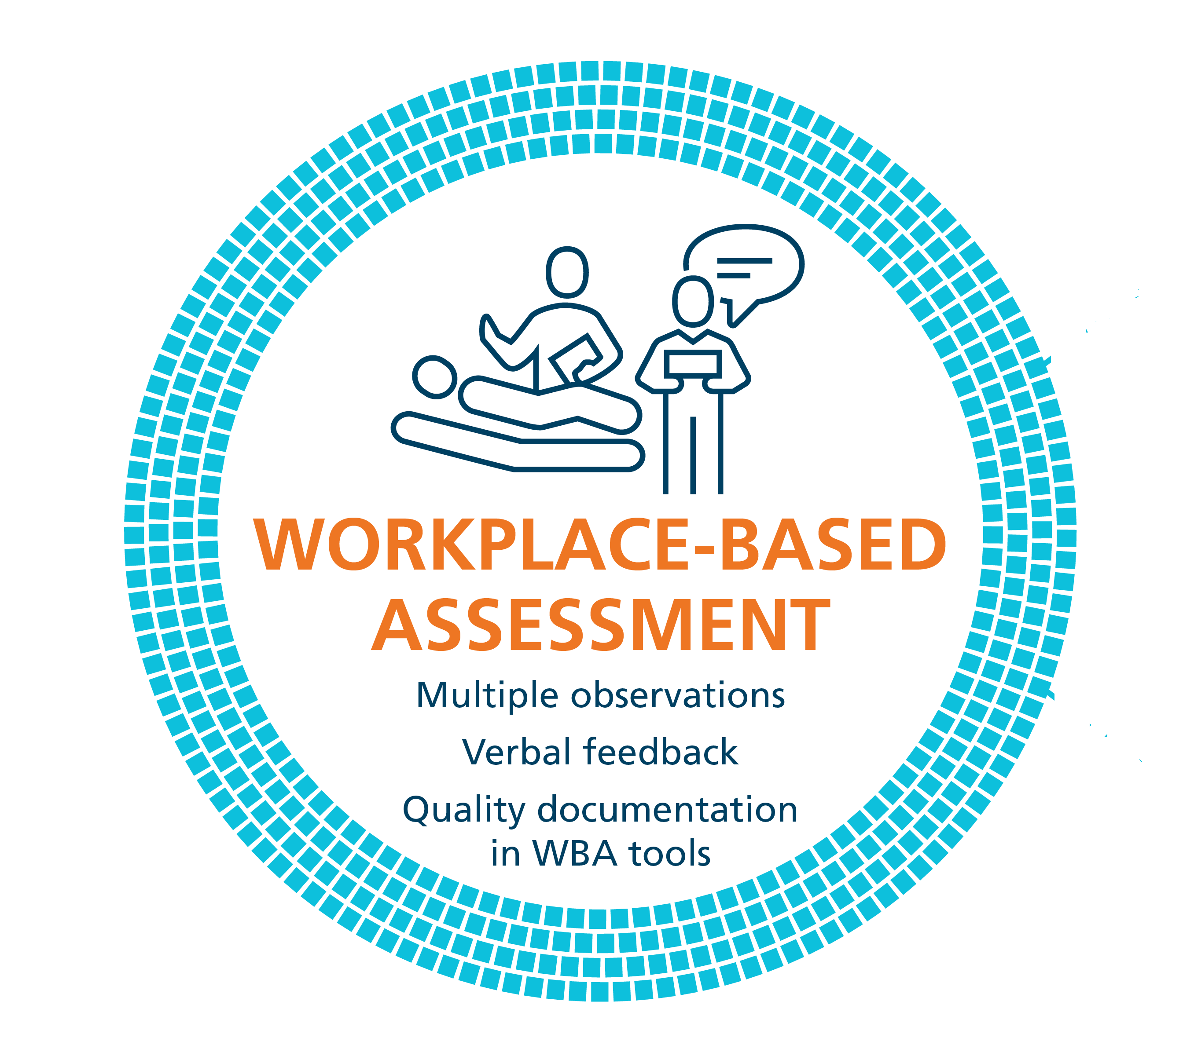
Coaching in the Moment:
A Process
RAPPORT
EXPECTATIONS
OBSERVE
COACH
RECORD
RX-OCR
Notes:
Coaching in the Moment follows a process, and when done well there is tremendous value in the information given and its utility for the resident’s learning.
This process has been coined as the RX-OCR coaching process. It occurs between the clinician teacher, who we now refer to as “clinician coach”, and the resident.
The steps in the process are:
1) R: Establishing educational “Rapport” between the resident and the clinician; an educational alliance or partnership;
2) X: Setting “eXpectations” for the particular clinical time period;
These initial 2 steps need not take longer than a few minutes.
3) O: “Observing” some type of work that the resident does;
4) C: Engaging in a “Coaching” conversation for the purpose of improvement of that work;
5) R: “Record” a summary of the dialogue that occurred so that the resident can build a portfolio of observations demonstrating progress and areas to be improved.
The next slides will elaborate on each step.

Slide 14

Initial Conversation: Rapport
Employ techniques to create a safe learning environment
Form an educational partnership – Growth mindset
Being explicit about the part of the clinician’s role as a learning coach
RAPPORT
Notes:
The initial conversation, RAPPORT development, as implied, needs to occur at the outset of any learning experience as it will serve as foundational to convey to the resident an established safe learning environment.
Establishing this learning partnership (or educational alliance) between the resident and clinician is a critical reason for the initial conversation. It confirms, for the resident, the clinician’s engagement in the educational process, and specifically the clinician’s commitment to providing guidance for the growth and development of the resident; in other words, employing and conveying a growth mindset. Explicitly stating this is important to assure it is understood.
This initial discussion could also allow the resident to disclose past experiences and preferences related to learning and assessment. Similarly, the clinician could convey their style in the learning environment.
RAPPORT is the first “R” in RX-OCR
Image source: https://pixabay.com/en/shops-partnership-cooperation-1014038/

Slide 15
Factors affecting the Educational Partnership
MUTUAL UNDERSTANDING
of learner’s goals and how to attain them
Telio, S et al. 2015, Bing-You, R et al. 2017
PERCIEVED COMMITTMENT/ENGAGEMENT
of the educator to learner “improvement”
Eva K et al 2012, Telio, S et al. 2016
“Recipient’s” perception of the relationship is the key determinant of the alliance’s success
Notes:
Although the research in this area, particularly in the Medical Education domain is just beginning, there has been some work done that has identified factors that affect this Educational partnership:
An explicit and mutual understanding of the goals, expectations and roles influences the success of the interaction, as does the resident’s perception of the clinician teacher’s commitment and engagement in their learning process.
In other words, residents need to feel that we, as clinician teachers are genuinely committed to their learning; being fully present and employing an approach that purposefully promotes their learning is essential to building this partnership.
Taking those few minutes for Rapport building is important!
Beneficience Eva et al 2012, Adv in Health Sci Ed Theory Practice – commitment
Telio
Bowen – Med St perception 2017
Bing –You, Robert, Academic Medicine 2017

Slide 16
Initial Conversation: Expectations
Discuss specific learning goals and objectives, related to milestones, competencies and EPAs
EXPECTATIONS
Notes:
Discussing specific learning goals and objectives, particularly as related to milestones, competencies and EPAs (Entrustable Professional Activities) that the resident is currently working toward, while considering the particular expectations of the clinical setting, will assure that both the resident and clinician have a shared understanding and agreement from the outset.
Again, this discussion need not take longer than a few minutes at the beginning of a clinic or a day or week working together.
EXPECTATIONS is the “X” in RX-OCR

Slide 17
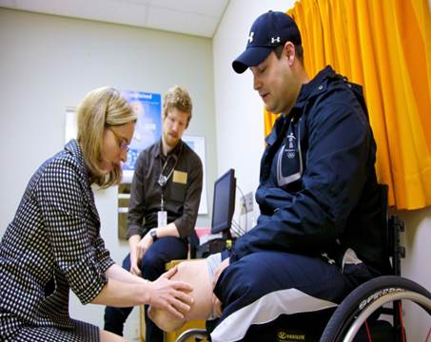
Observation of Work*
Workplace- Based Observation
* Key ingredient in Assessment FOR Learning
OBSERVE
Notes:
Observation is the cornerstone to workplace-based assessment and being able to provide coaching feedback. The workplace is ideally suited for learning by doing.
Clinical experiences may be short in duration (e.g. a resident spending one half day clinic with a particular staff clinician). However, such short duration clinical experiences DO NOT negate the possibility for “Coaching in the Moment”. It is essential that observations are made and suggestions for improvement given.
Related to clinic set up and flow, some of the direct observation of a resident may be more related to a clinical work task(s) needing to be done. In other words, what may be observed would be related more to the patient’s presenting condition rather than to the specific learning goals that were initially discussed. However, the resident’s goals and objectives (possibly the EPA being worked on) do need to be taken into account, and might require specific planned observations.
OBSERVE is the ‘O’ in RX-OCR

Slide 18
Observation
Direct Observation
a clinician watching a resident doing work
  in real time or asynchronously (i.e. videotaped)
Indirect Observation
review of products of the resident’s work
  clinical notes, presentations, or written reflections
observations from secondary sources
Notes:
FACILITATOR TIP: Your colleagues may have doubts about the practicality of “directly observing” everything all of the time for CBD. This slide is meant to reassure them that they don’t have to: indirect observation is ok too.
Direct observation of performance (i.e. when a clinician is watching the work being done – in real time or asynchronously, for example via video recording) is of paramount importance and needs to make up a substantive proportion of the observation of work that takes place.
However, this is not to say it is the only form of observation of work.
On some occasions, observation may occur indirectly. An example of an indirect observation of work includes review of products of the learner’s work. For example, a review of clinical notes, presentations, or written reflections would be indirect observations of a learner’s work. Additionally, another form of an indirect observation would be observations from secondary sources, such as in a multi-source feedback process. In this case, the observation of performance or work is done by someone else: another clinician, staff, patient or family but communicated back to the clinician working directly with the resident.

Slide 19
Engage in a Coaching conversation
Between the clinician and the resident
Related to the task that was observed
To ensure the resident understands how improvements could be made (growth mindset)
COACH
Notes:
Critical to the process is the dialogue that must occur between the clinician and the resident once the clinician has observed the resident or the resident’s work.
The purpose of this coaching conversation is to ensure the resident understands how improvements could be made. This is “coaching feedback”.
This type of coaching conversation would happen, most often, after the particular work task was completed but still “in the moment” of that clinical experience.
In some instances, this feedback may be offered as the work is being done with the clinician providing real time coaching in the moment. This, of course, needs to be agreed upon by the resident and the clinician prior to the observation occurring and is dependent on the context.
COACH is the ‘C’ in RX-OCR

Slide 20
Coaching
“a one-to-one conversation focused on the enhancement of learning and development through increasing self-awareness and a sense of personal responsibility, where the coach facilitates the self-directed learning of the [learner] through questioning, active listening, and appropriate challenge in a supportive and encouraging climate.”
Van Niewerburgh C, 2012
Notes:
Coaching is a form of teaching or competency focused instruction.
Within education, coaching has been defined as “a one-to-one conversation focused on the enhancement of learning and development through increasing self-awareness and a sense of personal responsibility, where the coach facilitates the self-directed learning of the [learner] through questioning, active listening, and appropriate challenge in a supportive and encouraging climate.”
Coaching may also be inquiries being deliberately asked by the “coach” (front line clinician) to stimulate thinking of other factors or alternatives. It is an exchange between the coach and the resident. The resident may clarify what is being offered.
Ref - Van Niewerburgh C: Coaching in Education: Getting Better Results for Students, Educators and Parents. London, Karnac Books, 2012.
[learner] replaced coachee in verbatim definition.

Slide 21
Coaching Feedback
Coaching Feedback
Feedback
Observation of Work
Coaching Feedback = feedback + actionable suggestions for improvement
Feedback = information about what was observed compared to an expected standard
Observer makes determination of quality of observed task
Notes:
In the CBD Coaching Model we encourage clinicians to think of themselves as coaches, guiding learners through a process that leads to performance enhancement. Coaches can help an individual to do a task better, develop a skill they don't yet possess or achieve a specific goal:
Like a good coach – clinical teachers must observe the resident practice a skill and then talk with the resident about what they saw. When clinicians do this, they’re giving residents feedback on what went well and what didn’t, compared to an expected standard.
The best coaches, though, continue the conversation with their athletes – they also discuss expectations for improvement and they identify specific things that the athlete can do to meet those expectations. Coaching helps a resident understand what adjustments and modifications will allow them to progress to the next level of capability/proficiency.
Feedback is defined as ‘'Specific information about the comparison between an observed performance and an expected standard, given with the intent to improve the trainee's performance.”
Coaching feedback is more than simply providing information, coaching feedback defines specific, actionable improvements that the resident can make and suggestions for how such improvements can be accomplished.
The CBD Coaching Model wants clinician teachers (observers) to aim towards the outer ring of this diagram (i.e. where the observer becomes a coach who offers the learner explicit, actionable suggestions for improvement).

Slide 22
Record a Summary
Recording a summary of feedback and actionable suggestions for improvement that were given is essential
Every Coaching interaction might not be documented but a representative sample during that clinical time is needed
It is important to document outlier performances because they could be rare but important
RECORD
Notes:
A final but essential step to the CinM process is for the clinician to take a few minutes to document a summary of the coaching feedback dialogue that takes place (at least some of the time) in the resident portfolio.
Every coaching interaction might not be documented in clinical experiences of longer duration, but a representative sample of the observations during that clinical time period is essential. For short duration clinical experiences (i.e. a resident spending only one half day clinic with a particular staff clinician) the goal should be for at least one coaching conversation to be recorded. In some instances, more than one observation of work and coaching opportunity might occur in one clinic and could be documented.
It is not critical that the clinician know whether what was observed is a representative performance of a task for a particular learner. Documenting observations and suggestions for improvement, whether representative or an outlier execution of a task, helps create a comprehensive illustration of competence. Any one observation leading to Coaching in the Moment is not high stakes and will not lead to grave consequences, but is part of the process to support resident development and progress.
Whether or not a clinician documents an encounter does not restrict the resident from making their own record of the feedback and suggestions given, including their personal reflections on how it was helpful for and/or integrated into their practice performance.
RECORD is the second ‘R’ in RX-OCR

Slide 23
CBD Coaching Model
Facilitating learning and development of a residents’ competence
Notes:
Now we’ll look at the second Coaching component of the Coaching Model: Coaching over Time.

Slide 24
Coaching Over Time
Another educational partnership/alliance
A longitudinal relationship between
clinician and learner
Learners: greater responsibility for
reviewing observation data &
setting learning goals
Notes:
FACILITATOR TIP: Each program is likely to operationalize the concept of “coaching over time” a bit differently. No matter how you do it (i.e. whether the PD takes on this role or a faculty advisor or some other person), the important thing is that your program recognizes and supports a longer-term relationship between the learner and someone who can help guide their learning over time.
Coaching over Time calls for a longitudinal educational partnership between a clinician and resident. This relationship is for the purpose of progression of competence and development of lifelong learning skills (for eventual self-regulated learning). This clinician-resident relationship lasts longer than any one clinical experience, and this extended period of time would allow for the relationship to be deeper than the clinician-resident relationship formed during Coaching in the Moment.
Coaching over Time involves deep, authentic and reflective discussions, sees and addresses patterns, and plans how to address gaps and issues. Given the potential content of such discussions, assuring a safe learning environment is essential. This role could be filled by a program director, faculty advisor (optional), etc.
While Coaching in the Moment should occur almost daily throughout the residency, and can be given by all frontline clinicians, Coaching over Time will also play a crucial function. It must include regularly scheduled face-to-face discussions and decisions about progress toward competence as an essential occurrence. There may be instances when the content of such conversations is more critical, therefore, the need for a well-established trusting relationship will be greater; it is essential that the resident feels confident that the clinician has their best interests in mind.
In CBD, a more individualized learning process is supported. However, this needs residents to assume responsibility for reviewing data and planning their learning goals.
“Coaching in the Moment” and “Coaching over Time” are the foundations to this Coaching Model and are of paramount importance to CBME. Some clinicians might fulfill more than one of these roles, especially in smaller programs.

Slide 25
Coaching Over Time: Two Goals
To guide residents in their clinical performance progress:
  Help to synthesize the multiple types of observation data received
To facilitate the learner’s development of skills in self-regulated learning by engaging the learner in the process of guided self-assessment. Help the learner to:
  Set learning goals
  Process feedback and observation data related to goals
  Establish or revise new learning goals in response to their progress or other data
Notes:
Coaching over time is imperative to guiding residents in their clinical performance progress and helping them develop into competent clinicians. Coaching over time helps residents to make sense of the multiple types of observation data. Additionally, it also should facilitate the learner’s development as a self-regulated learner over the course of their formal education.

Slide 26

Portfolio Data
Caverzagie and Lobst
Notes:
With CBD and WBA, residents receive many types and a far greater volume of assessment data, the most frequent of which should be recorded observations that happen in the course of day-to-day clinical work (from Coaching in the Moment). Although every variation of every task will not be observed, these data windows or biopsies (snapshots of work over time) will illuminate the bigger picture of how the resident is progressing toward competence. The more windows (observations), the clearer the picture of competence.
As part of Coaching over Time, Program Directors and/or other clinicians fulfilling this role will give residents guidance and input on how to synthesize the assessment data from a variety of sources in order to adjust their behaviours and performance. These conversations and coaching that occurs as a result are part of Coaching over Time.

Slide 27
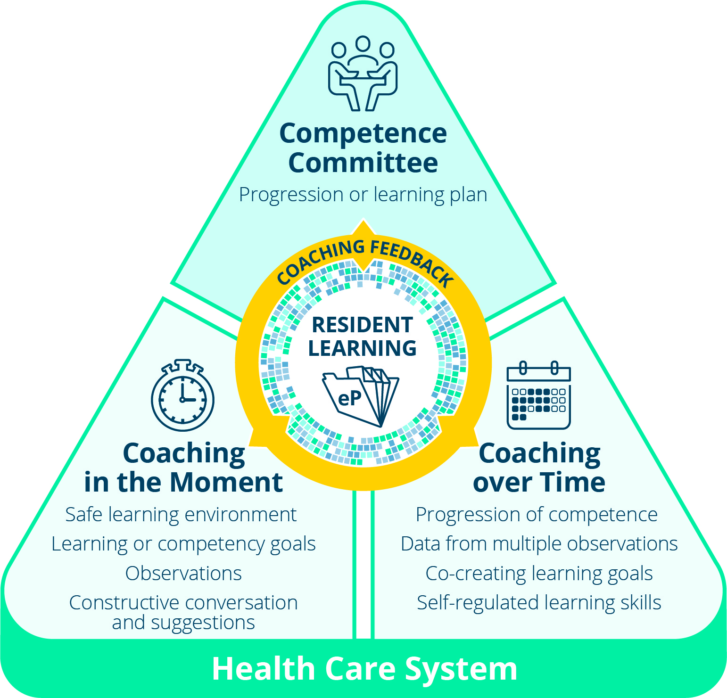
Coaching and Progression Model
Coaching and competence committees:
Competence Committees - decide
Coaches – develop
Notes:
The coaching and progression model shows the relationship between coaching and competence committees. As part of programmatic assessment, a competence committee plays an important role in supporting a resident’s developmental acquisition of competencies. A competence committee is responsible for regular review of resident progress using highly integrative data from multiple EPA and milestone observations and coaching feedback in clinical practice. A resident and their “Coach over Time” may use competence committee reviews and recommendations in the pursuit of that resident’s mastery and excellence of performance.

Slide 28
Summary
Resident Learning & Development
Educational Partnerships
Assessment FOR Learning (observations)
Coaching Feedback for Improvement
Coaching in the Moment
  Multiple low stakes observations
  RX-OCR
Coaching over Time
  Guiding resident progression over time
  Facilitating lifelong learning skills
Notes:
In summary, the CBD Coaching Model has several novel elements (as listed) that align with and will facilitate a resident’s acquisition of competence over the stages of training in a CBME system (as listed on the slide and covered in the previous slides).

Slide 29
References
Archer, J et al. 2010. State of the science in health professions education and effective feedback. Medical Education. 44 (1): 101-8.
Bing-You et al. 2018. The Feedback Tango: An Integrative Review and Analysis of the Content of the Teacher–Learner Feedback Exchange. Academic Medicine. (e-pub ahead of print, 2017).
Constance, L et al. 2010. Coaching in Emergency Medicine. Canadian Journal of Emergency Medicine. 12 (6): 520-4
Deiorio, N et al. 2016. Coaching: A new model for academic and career achievement. Medical Education Online. 21 (1).
Notes:
Archer, J et al. 2010. State of the science in health professions education and effective feedback. Medical Education. 44 (1): 101-8.
Bing-You et al. 2018. The Feedback Tango: An Integrative Review and Analysis of the Content of the Teacher–Learner Feedback Exchange. Academic Medicine. (e-pub ahead of print, 2017).
Constance, L et al. 2010. Coaching in Emergency Medicine. Canadian Journal of Emergency Medicine. 12 (6): 520-4
Deiorio, N et al. 2016. Coaching: A new model for academic and career achievement. Medical Education Online. 21 (1).
Gifford, K et al. 2014. Doctor Coach: a deliberate practice approach to teaching and learning clinical skills. Academic Medicine. 89 (2): 272-6.
Ross, S et al. 2016. Context, time, and building relationships: bringing in situ feedback into the conversation. Medical Education. 50 (9): 893-5.
van de Ridder, JM et al. 2008. What is feedback in clinical education? Medical Education. 42 (2): 189-97.
Sargeant, J et al. 2017. R2C2 in Action: Testing an Evidence-Based Model to Facilitate Feedback and Coaching in Residency. Journal of Graduate Medical Education. 9 (2): 165-70.
Telio, S. 2015. The "educational alliance" as a framework for reconceptualizing feedback in medical education. Academic Medicine. 90 (5): 609-14.
Telio, S. 2016. Feedback and the educational alliance: examining credibility judgements and their consequences. Medical Education. 50 (9): 933-42.
Watling, C et al. 2014. Learning culture and feedback: an international study of medical athletes and musicians. Medical Education. 48 (7): 713-23.

Slide 30
References
Gifford, K et al. 2014. Doctor Coach: a deliberate practice approach to teaching and learning clinical skills. Academic Medicine. 89 (2): 272-6.
Ross, S et al. 2016. Context, time, and building relationships: bringing in situ feedback into the conversation. Medical Education. 50 (9): 893-5.
van de Ridder, JM et al. 2008. What is feedback in clinical education? Medical Education. 42 (2): 189-97.
Sargeant, J et al. 2018. The R2C2 Model in Residency Education: How Does It Foster Coaching and Promote Feedback Use? Academic Medicine. Volume publish ahead of print. Retrieved from: https://journals.lww.com/academicmedicine/Abstract/publishahead/The_R2C2_Model_in_Residency_Education___How_Does.98012.aspx

Slide 31
References
Telio, S. 2015. The "educational alliance" as a framework for reconceptualizing feedback in medical education. Academic Medicine. 90 (5): 609-14.
Telio, S. 2016. Feedback and the educational alliance: examining credibility judgements and their consequences. Medical Education. 50 (9): 933-42.
Watling, C et al. 2014. Learning culture and feedback: an international study of medical athletes and musicians. Medical Education. 48 (7): 713-23.

